Slide 1
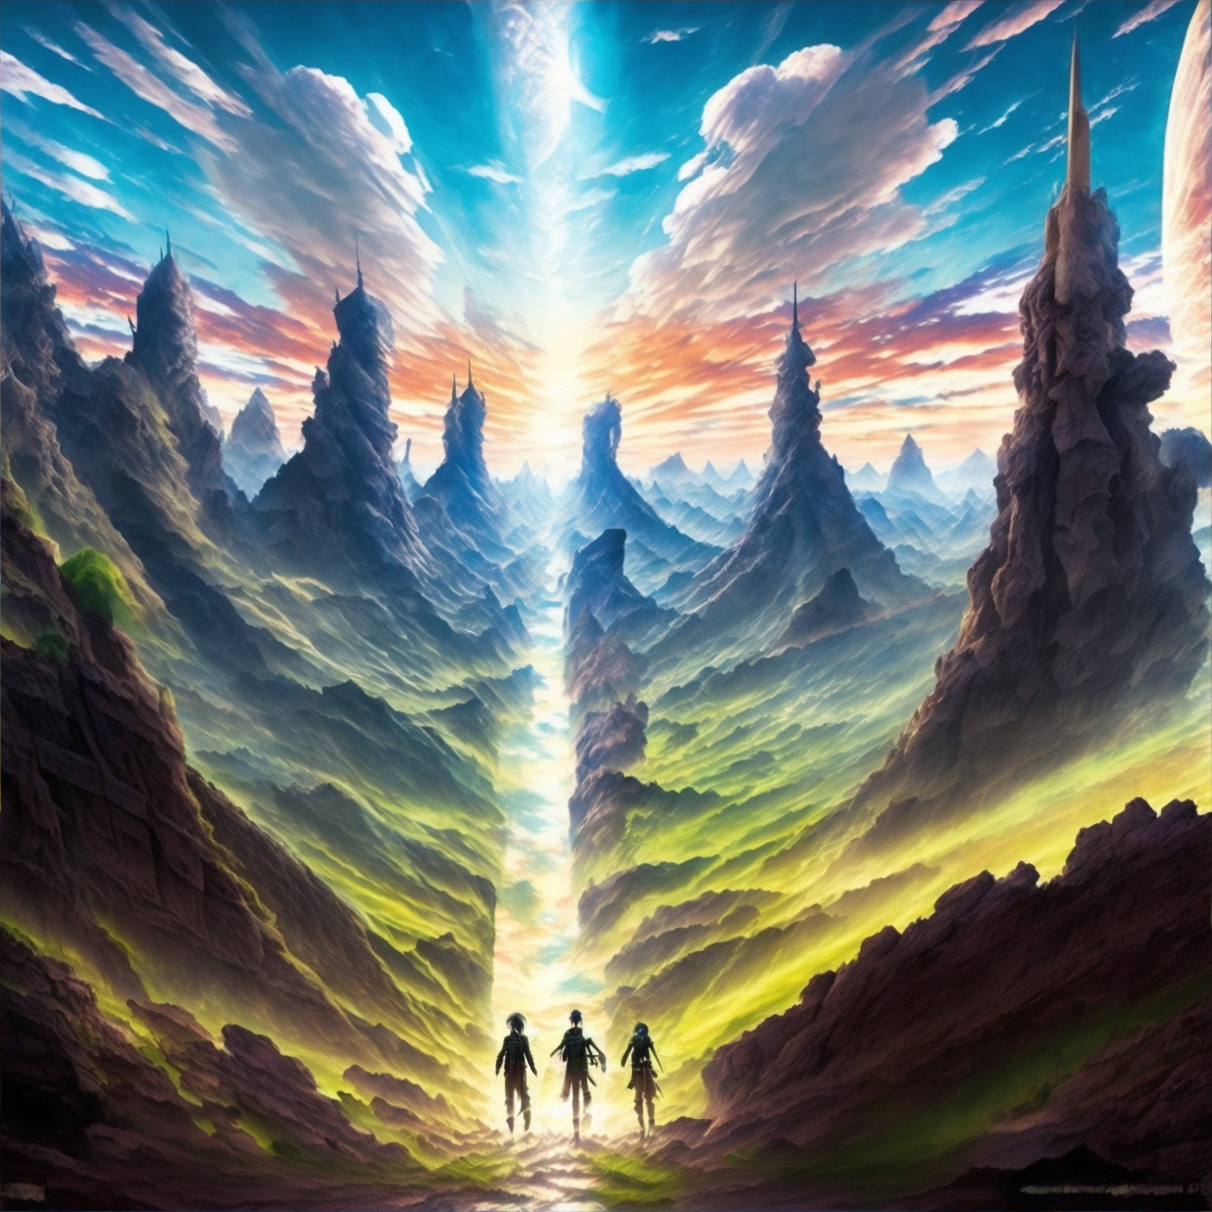
My Game Development Niche
& Game Proposal

Slide 2
GAME DEVELOPMENT NICHE
My Game Development Niche = Role-Playing Game (RPG)
Role-Playing Games (RPG):
Role-Playing Games (RPGs) are a genre of video games that place a strong emphasis on storytelling, character development, and player choice. In RPGs, players assume the roles of fictional characters within a virtual world and embark on adventures, often within a richly detailed and immersive narrative.
Some key elements and features commonly found in RPG games are
Character Creation
Narrative and Quests
Exploration and Open Worlds
Character Development and Progression
Non-Player Characters (NPCs)
Combat and Gameplay Mechanics

Slide 3
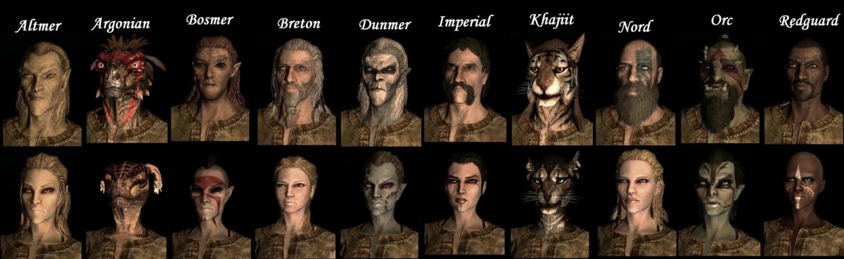
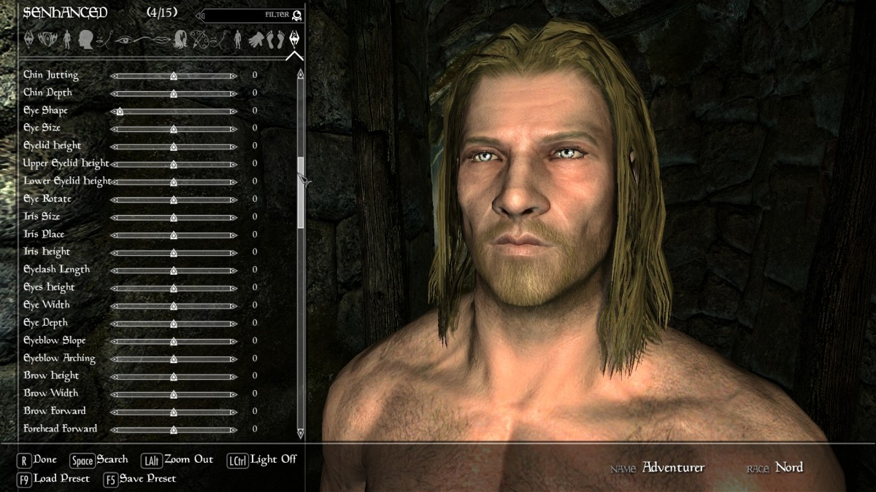
KEY ELEMENTS OF RPG (CHARACTER CREATION)
CHARACTER CREATION
Character creation is a process within RPG games that allows players to customize and personalize their in-game characters according to their preferences. It is an important aspect of RPGs as it allows players to shape the identity, appearance, and abilities of their virtual avatars. Let’s discuss character creation in “The Elder Scrolls V: Skyrim”. In "Skyrim," character creation is the first step players take before starting their adventure in the vast open world of the game. Here's how the process typically unfolds:
Race Selection:
Players begin by choosing the race of their character. "Skyrim" offers several races, each with its own unique abilities, strengths, and cultural backgrounds. The available races include humans (Nords, Imperials, Redguards), elves (High Elves, Wood Elves, Dark Elves), and various other races such as Orcs, Khajiit (cat-like humanoids), and Argonians (reptilian humanoids). Each race has different starting attributes and special abilities, which can influence gameplay.
Appearance Customization:
Once the race is chosen, players can modify the appearance of their character. This includes selecting facial features like hairstyle, hair color, eye shape, eye color, facial hair (for males), and body build. The game provides a wide range of options, allowing players to create unique and visually distinct characters.

Slide 4
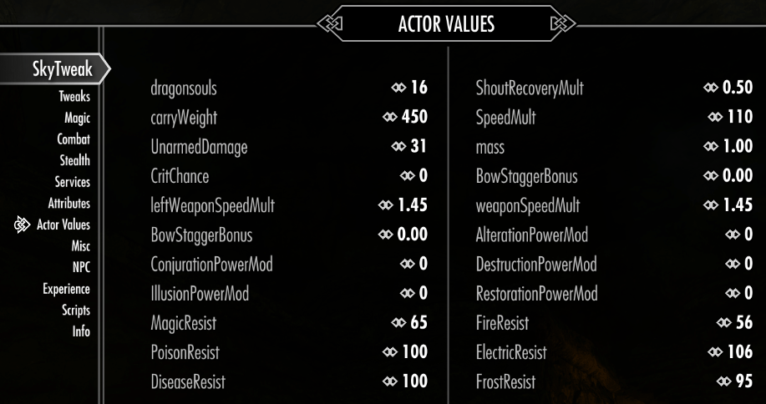
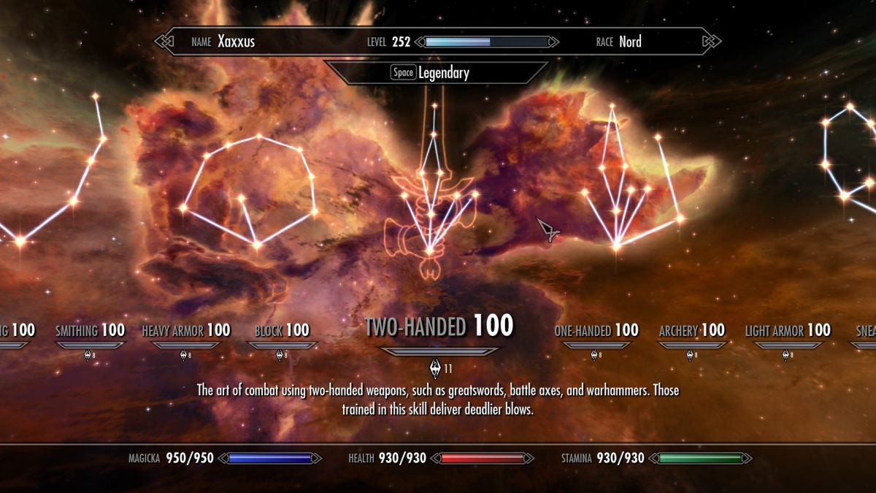
KEY ELEMENTS OF RPG (CHARACTER CREATION)
Attributes and Skills:
After establishing the character's appearance, players allocate attribute points to define their starting capabilities. "Skyrim" features various attributes such as health, magicka (used for casting spells), and stamina (used for physical actions like running and attacking). The distribution of attribute points determines the initial values of these attributes. Additionally, players can also choose a specialization (warrior, mage, or thief) that affects the character's starting skills and abilities.
Skill Selection:
"Skyrim" utilizes a skill-based system where players can improve various abilities by using them repeatedly. At character creation, players choose a set of skills that align with their intended playstyle. Skills in "Skyrim" include combat skills (one-handed weapons, archery, destruction magic), stealth skills (sneak, lockpicking), crafting skills (smithing, alchemy), and more. The initial skill levels determine the character's proficiency and the rate at which those skills improve over time.
Background and Backstory:
While "Skyrim" doesn't have an extensive background selection, players can mentally craft a backstory for their character. This backstory can include elements such as the character's upbringing, past experiences, motivations, and personal goals. Although not explicitly tied to gameplay mechanics, having a backstory adds depth and role-playing possibilities to the character.

Slide 5
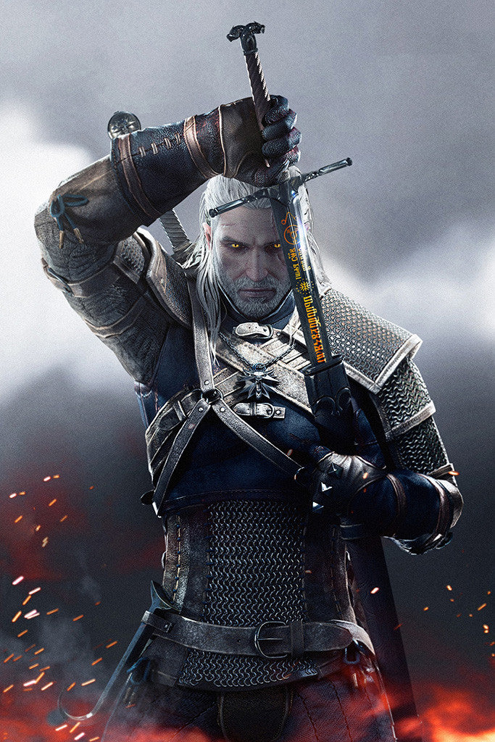
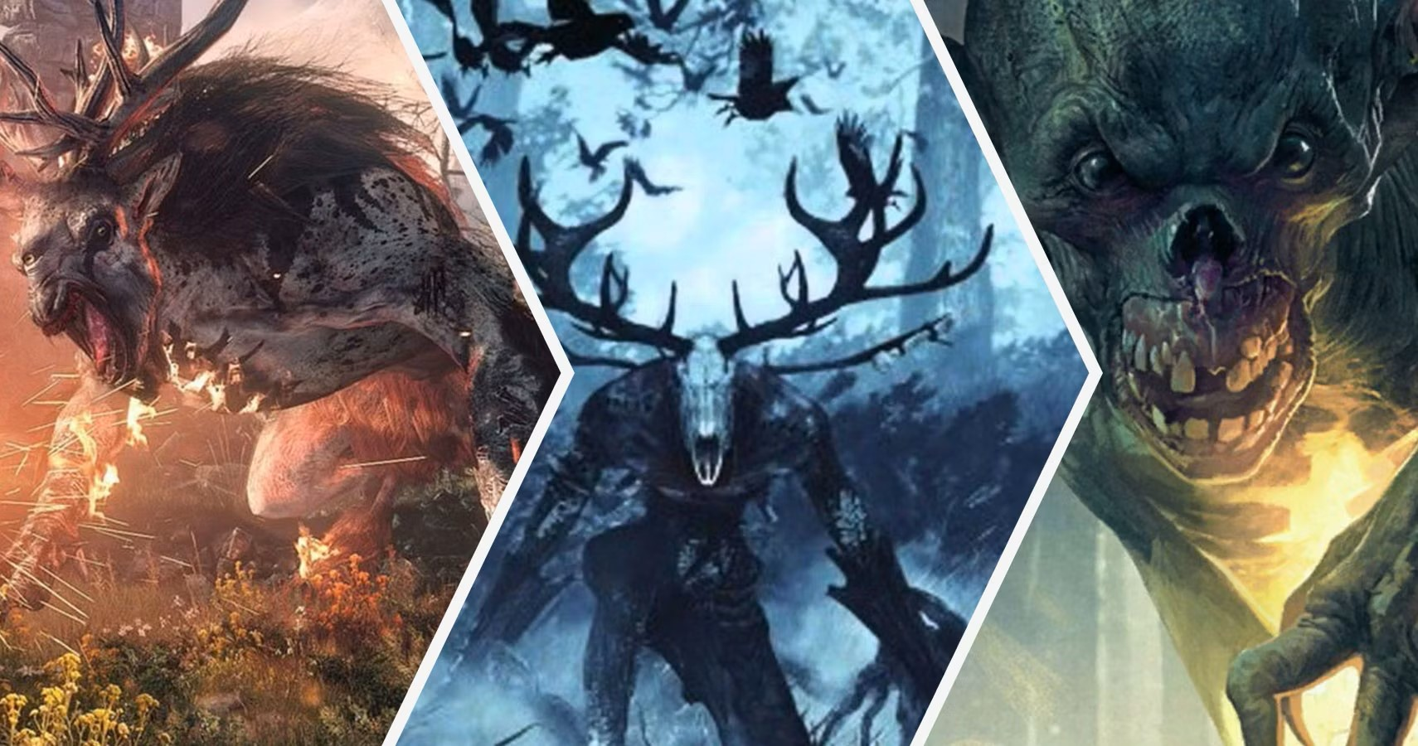
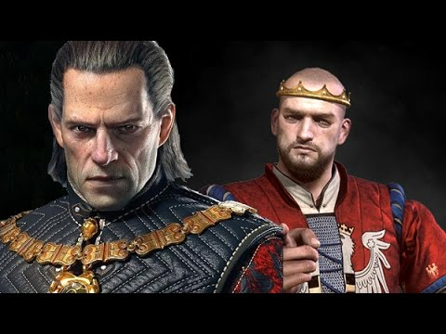
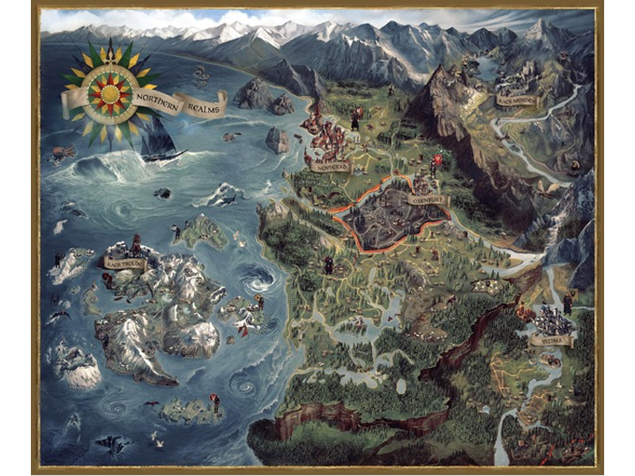
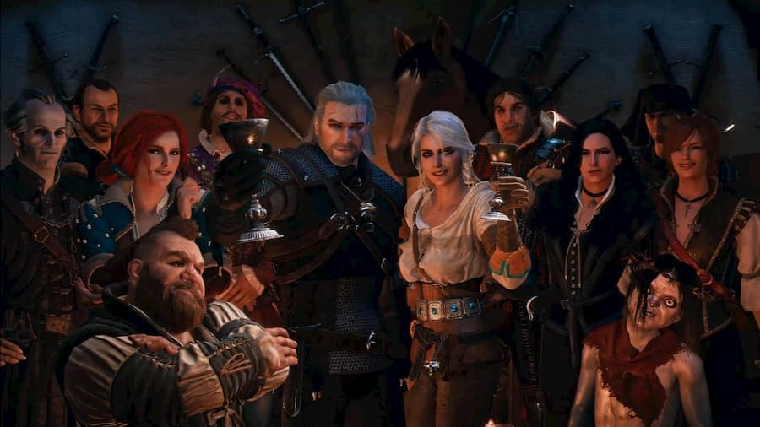
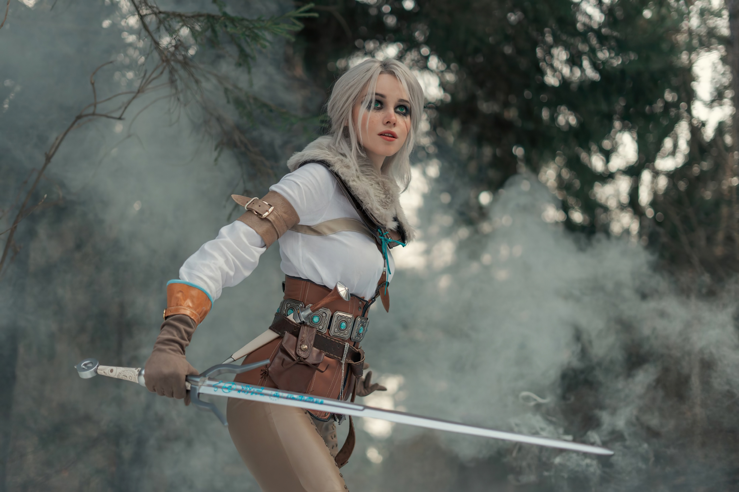
KEY ELEMENTS OF RPG (NARRATIVE AND QUESTS)
2. NARRATIVE AND QUESTS
Narrative and quests are integral components of RPG games that provide players with a structured storyline and engaging objectives to pursue. They guide players through the game's world, unraveling a compelling narrative and offering a sense of purpose and progression. To illustrate these elements, let's explore the game example of “The Witcher 3: Wild Hunt”. It is an open-world RPG known for its rich storytelling and immersive quests. Here's how the narrative and quests unfold in the game:
Main Storyline:
The game's main narrative follows Geralt of Rivia, a skilled monster hunter and protagonist of the series. Players assume the role of Geralt and embark on a quest to find his adopted daughter, Ciri, while navigating a war-torn fantasy world called the Northern Realms. The main storyline introduces complex characters, political intrigue, and supernatural threats, offering a deep and immersive narrative experience.

Slide 6
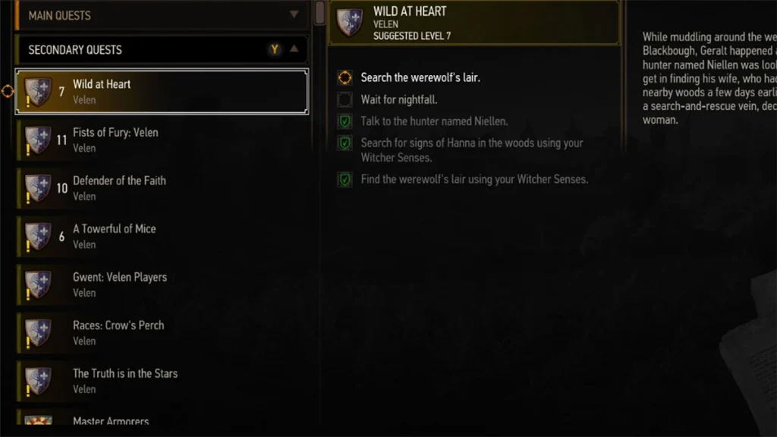
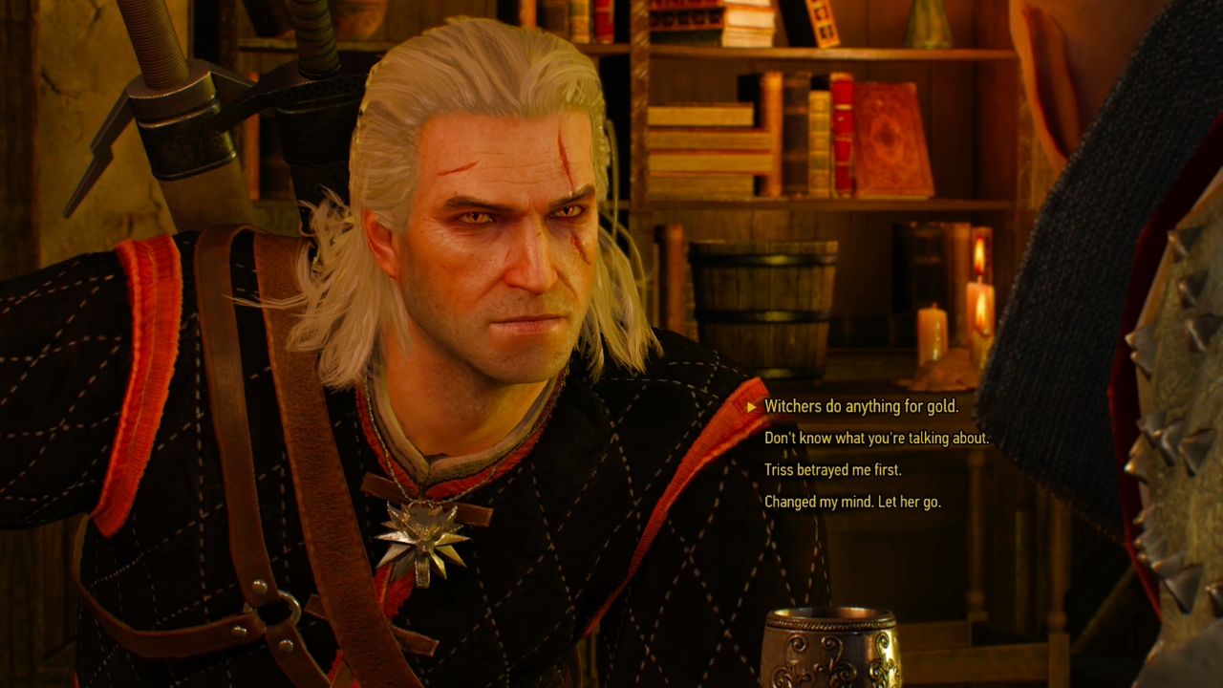
KEY ELEMENTS OF RPG (NARRATIVE AND QUESTS)
Side Quests:
Alongside the main storyline, "The Witcher 3" features a plethora of side quests that expand upon the game's world and provide additional depth to the narrative. These quests involve interacting with various characters, solving mysteries, assisting townsfolk, or exploring intriguing locations. Side quests often feature branching paths, allowing players to make choices that can impact the outcome or provide moral dilemmas, making the world feel alive and reactive to player decisions.
Dialogue and Choices:
Dialogue plays a significant role in narrative progression. Players engage in conversations with non-player characters (NPCs), making choices that influence the course of events and relationships. The choices can have far-reaching consequences, affecting character outcomes, alliances, and the overall story. Dialogue choices in "The Witcher 3" often reflect Geralt's personality, presenting opportunities for role-playing and shaping the character's identity.

Slide 7
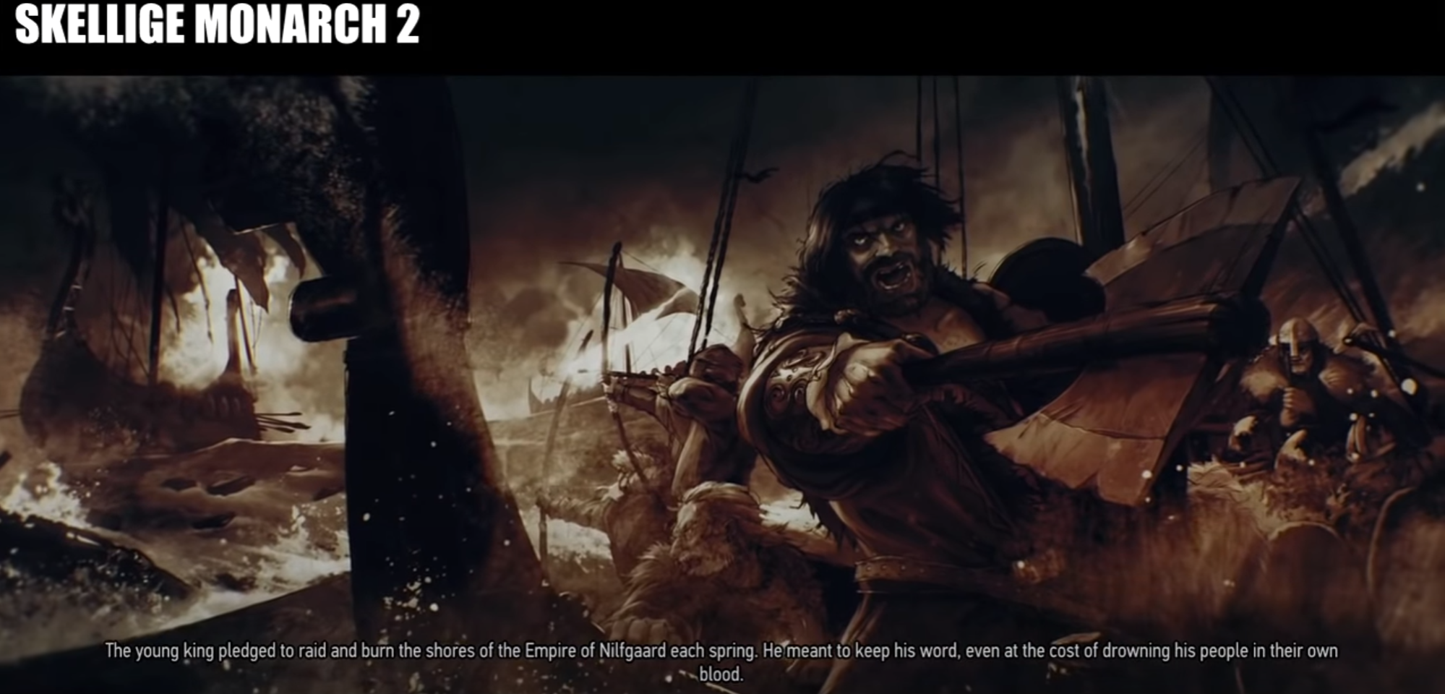
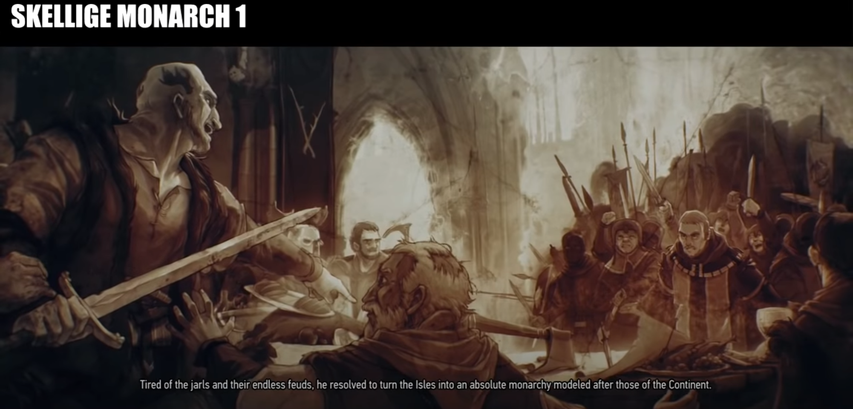
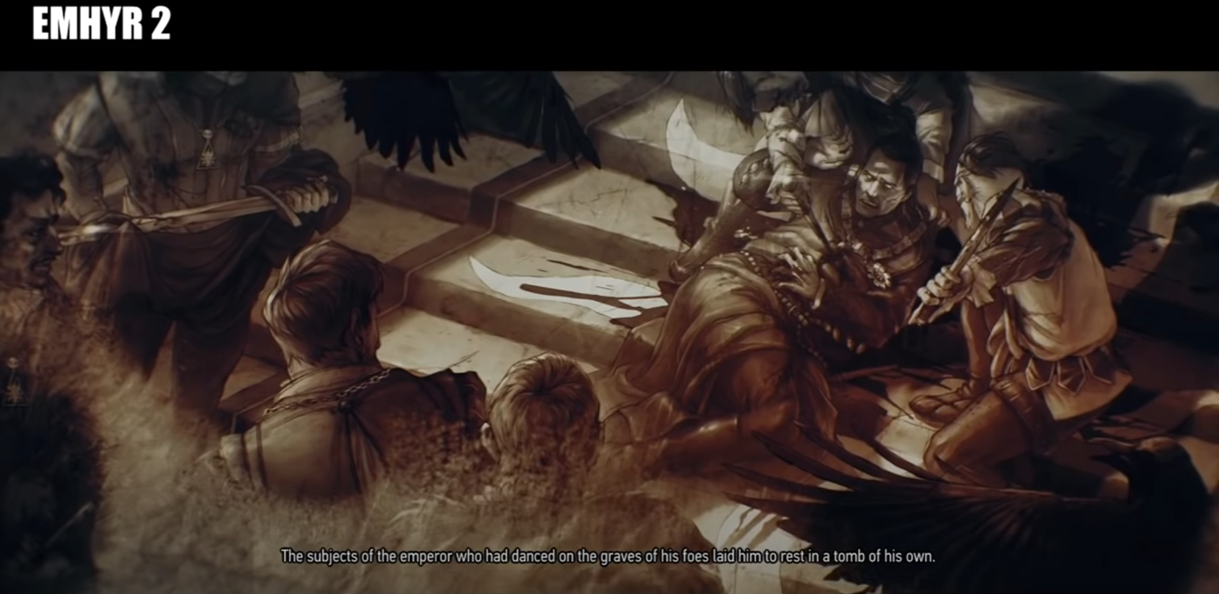
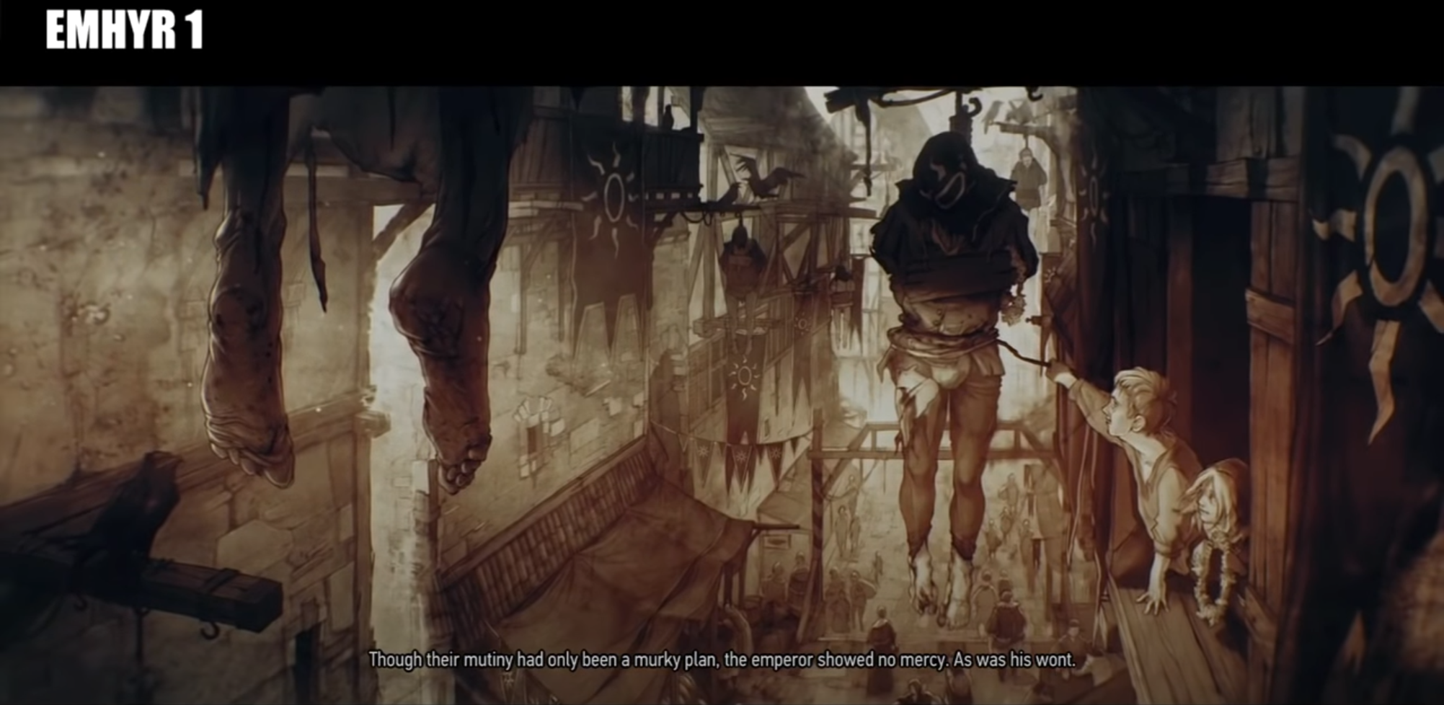
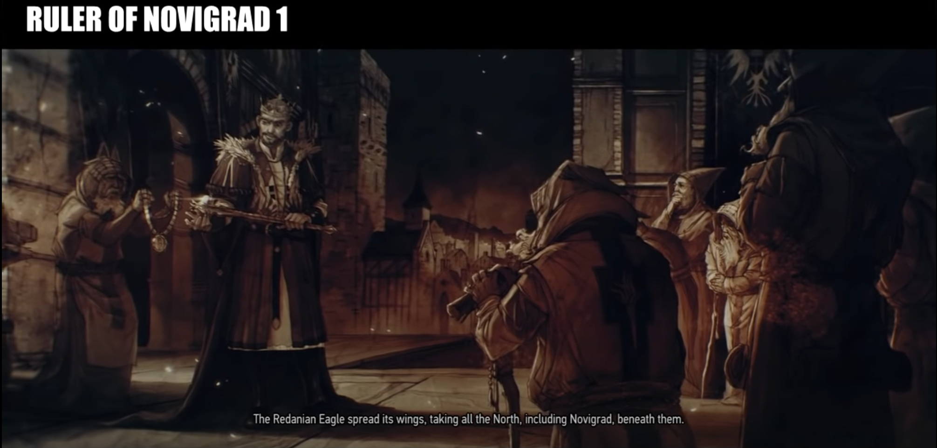
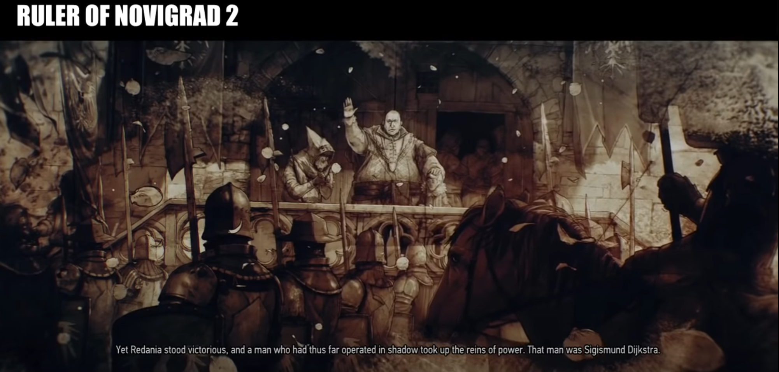
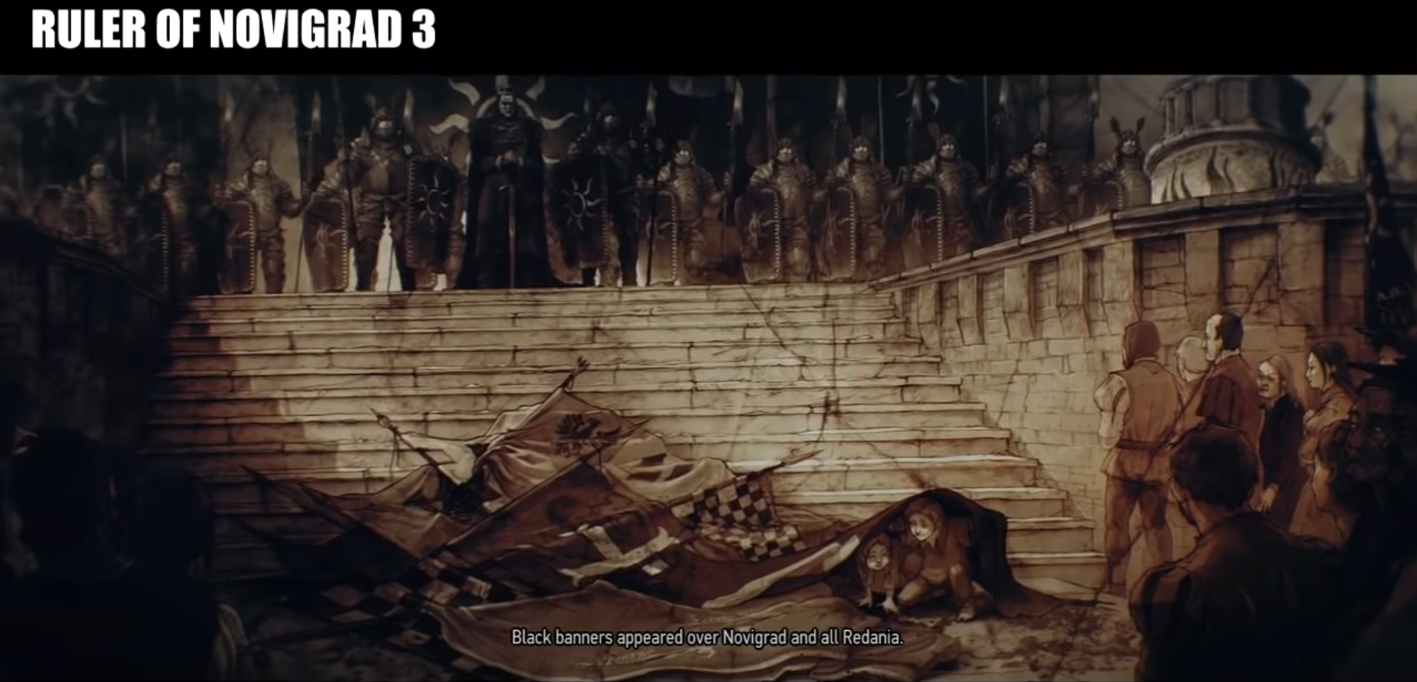
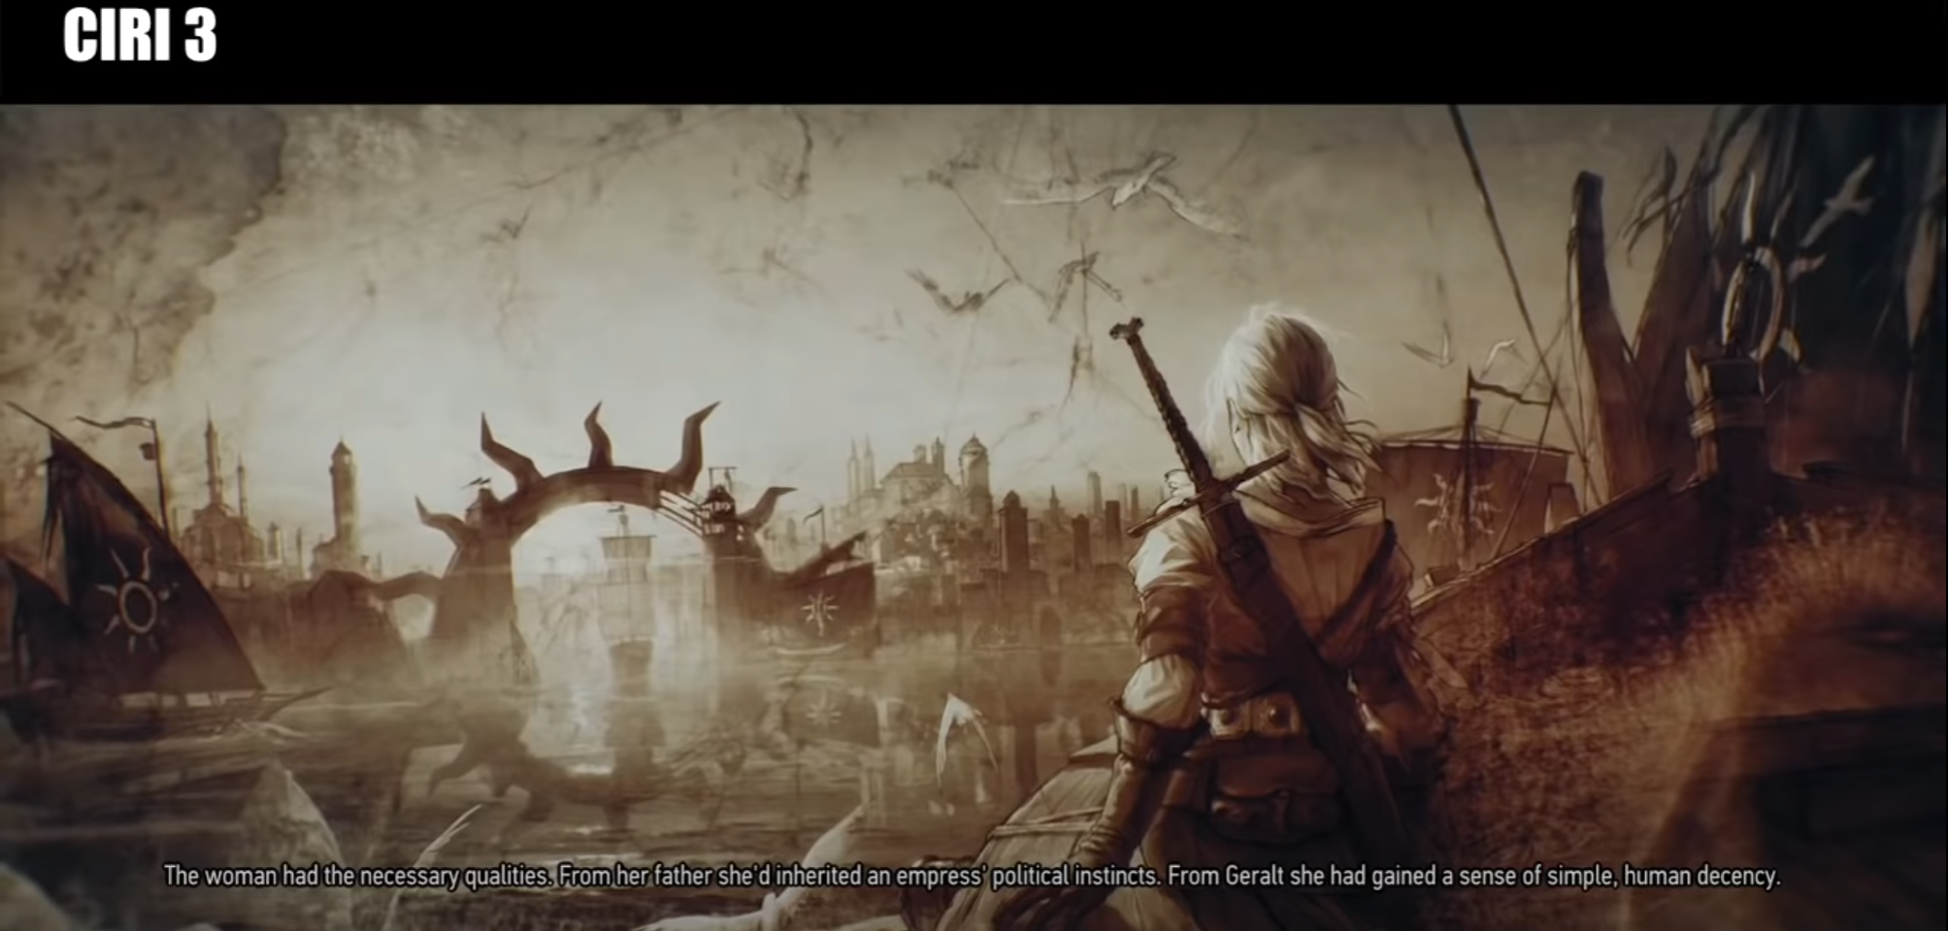
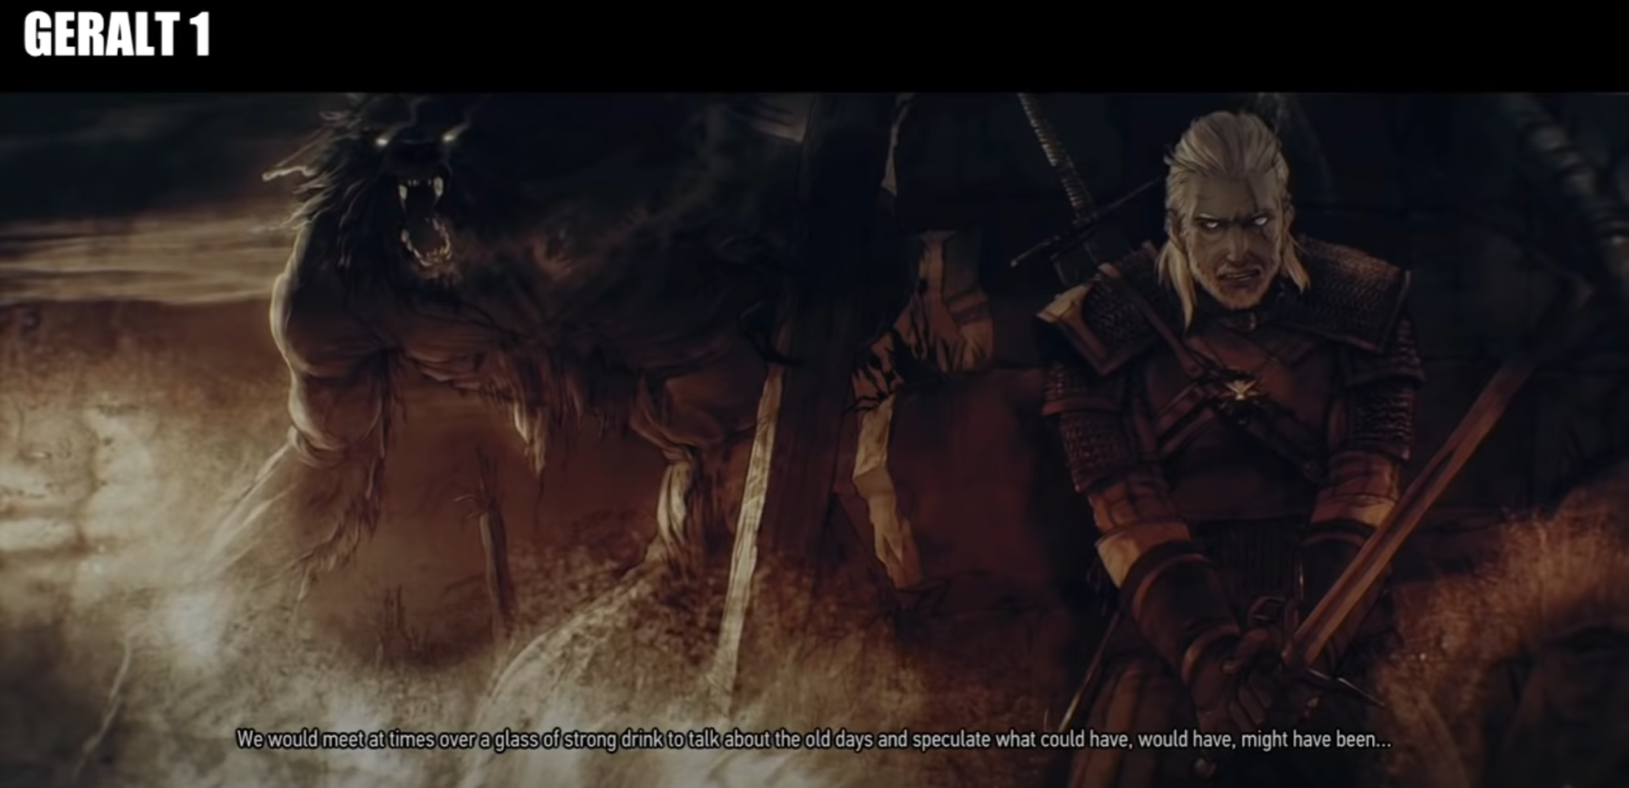
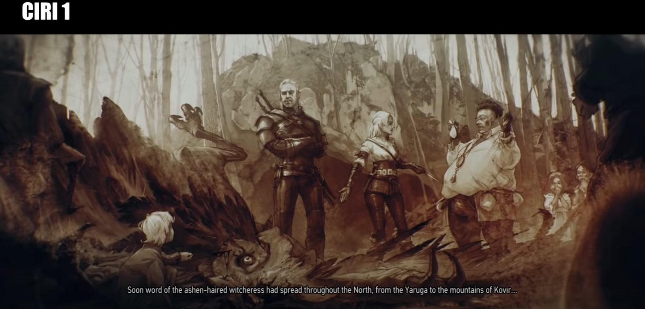
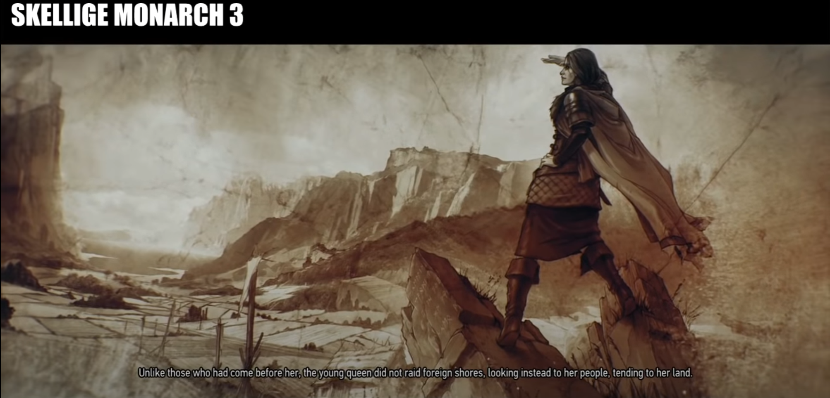
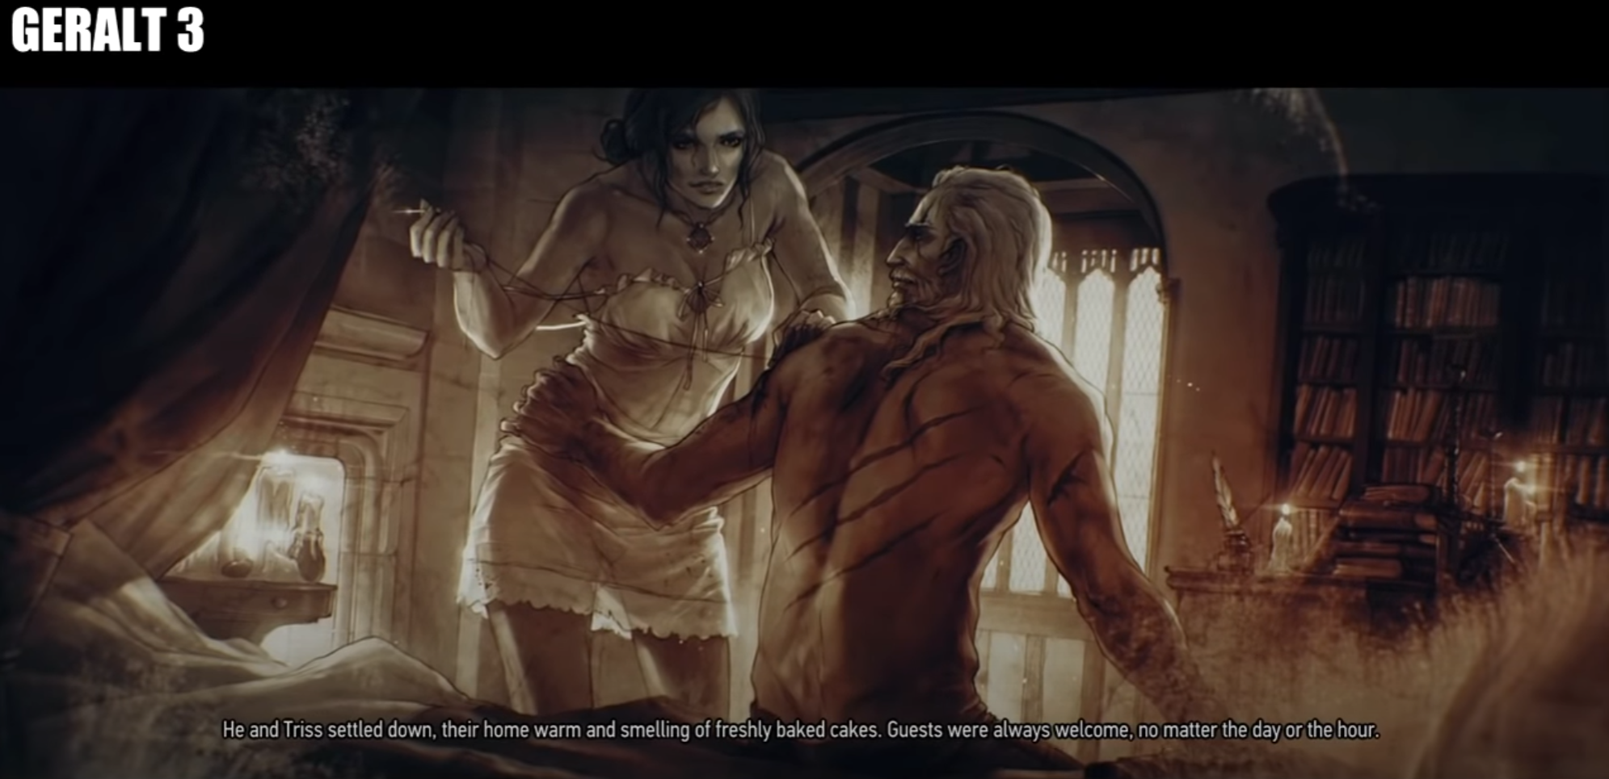
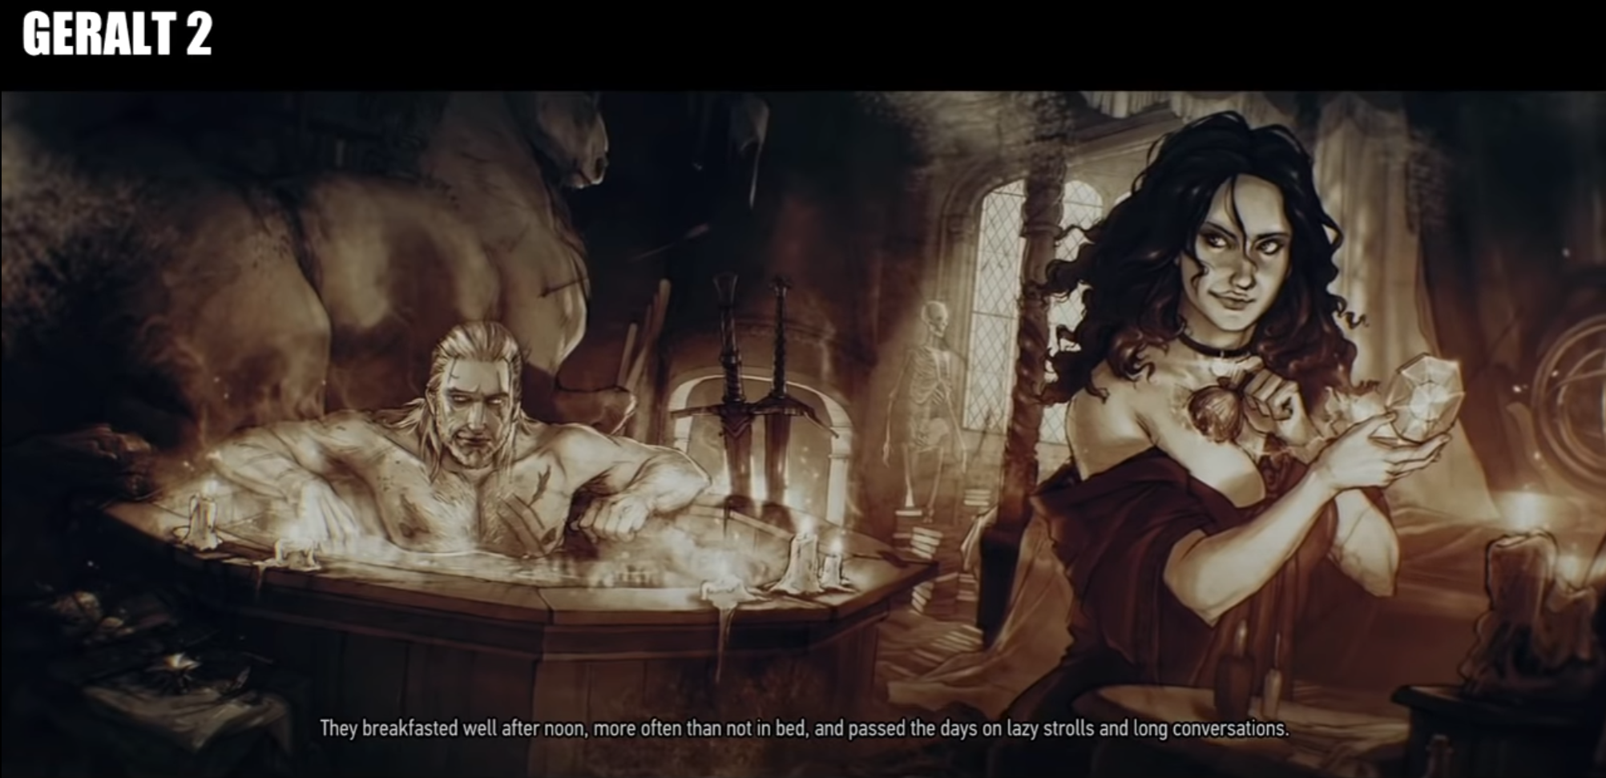
KEY ELEMENTS OF RPG (NARRATIVE AND QUESTS)
Multiple Endings:
"The Witcher 3" employs a branching narrative structure that leads to multiple possible endings. The choices made throughout the game, including interactions with key characters and factions, impact the final outcome. The game's narrative flexibility allows for meaningful player agency, enhancing replayability and encouraging players to explore different paths and consequences.

Slide 8
KEY ELEMENTS OF RPG (NARRATIVE AND QUESTS)
Lore and World-building:
The game world of "The Witcher 3" is based on the novels by Andrzej Sapkowski and is rich in lore and history. Through environmental storytelling, books, and dialogues, players learn about the world's factions, conflicts, myths, and monsters. This world-building contributes to the immersive experience and provides context for quests and character motivations.
Dynamic Events:
The game world in "The Witcher 3" is dynamically populated with events and encounters that occur organically. These events can include bandit ambushes, monster attacks, or random encounters with NPCs in need of assistance. These dynamic events create a living world and provide additional quests or opportunities for players to engage with.
Conclusion:
"The Witcher 3: Wild Hunt" demonstrates how a captivating narrative and well-designed quests can immerse players in a detailed and morally complex fantasy world. The combination of a compelling main storyline, branching quests, impactful choices, and a richly developed lore creates a memorable and engaging RPG experience, where players feel invested in the fate of the characters and the world they inhabit.

Slide 9
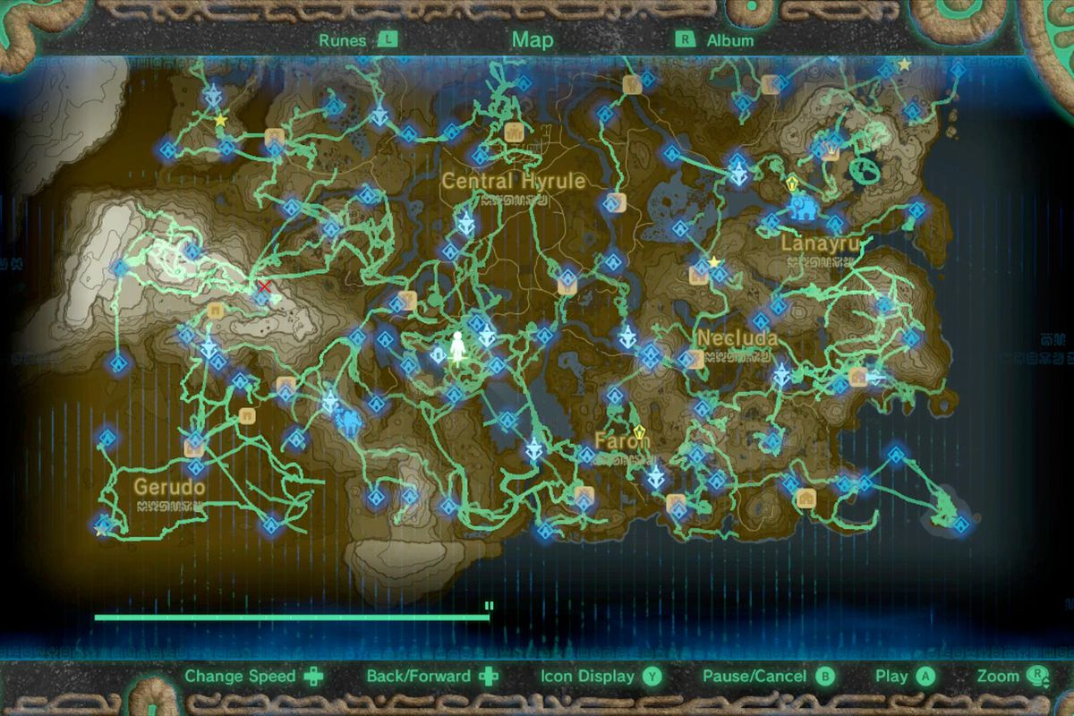
KEY ELEMENTS OF RPG (EXPLORATION & OPEN WORLD)
EXPLORATION & OPEN WORLD
Exploration and open worlds are core features of many modern RPG games, providing players with expansive and immersive environments to discover, navigate, and interact with. These elements offer a sense of freedom and discovery, allowing players to venture off the beaten path, uncover hidden secrets, and shape their own unique experiences. To illustrate these concepts, let's delve into the game example of “The Legend of Zelda: Breath of the Wild”. It is an action-adventure RPG known for its vast open world and emphasis on exploration. Here's how the game exemplifies exploration and open worlds:
Open World Map:
BOTW presents a massive and diverse open world known as Hyrule. The game's map is seamlessly interconnected, allowing players to freely traverse the land without load screens. From sprawling grasslands to towering mountains, dense forests, vast deserts, and tranquil lakes, Hyrule is filled with a wide range of environments that encourage players to explore and uncover its secrets.
Non-Linear Progression:
BOTW offers a non-linear progression system, enabling players to approach the game's challenges and quests in any order they desire. Unlike traditional linear games, players have the freedom to choose their own path, deciding where to go and what to do. This open-ended structure empowers players to explore areas at their own pace and tackle quests or objectives in a manner that suits their playstyle.

Slide 10
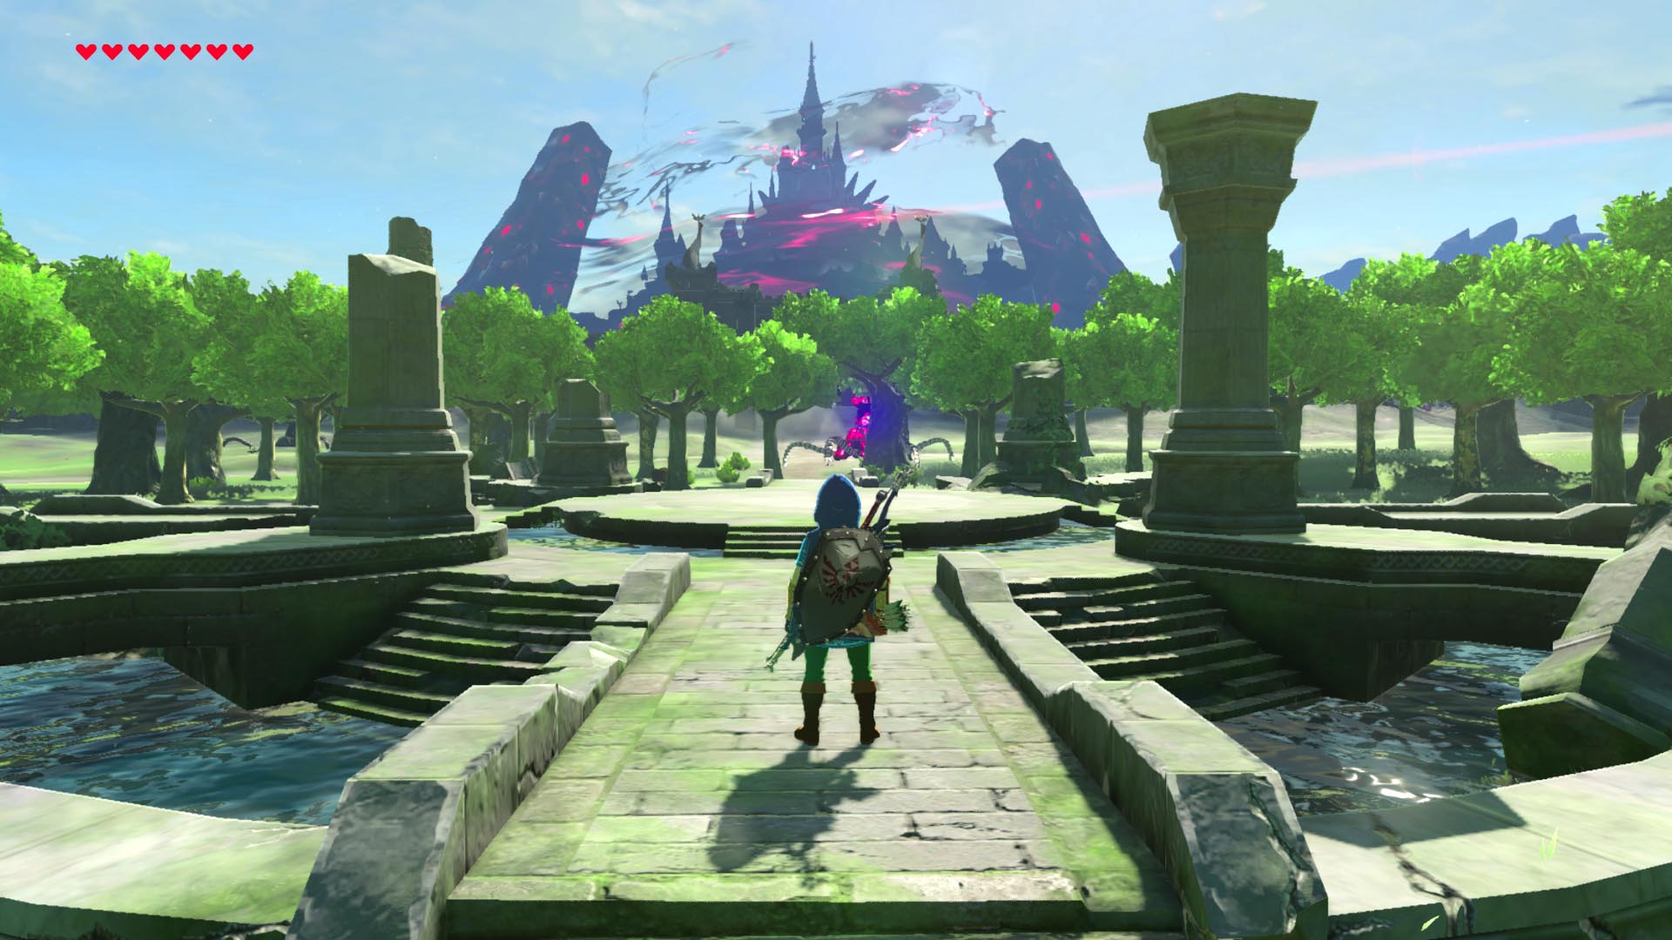
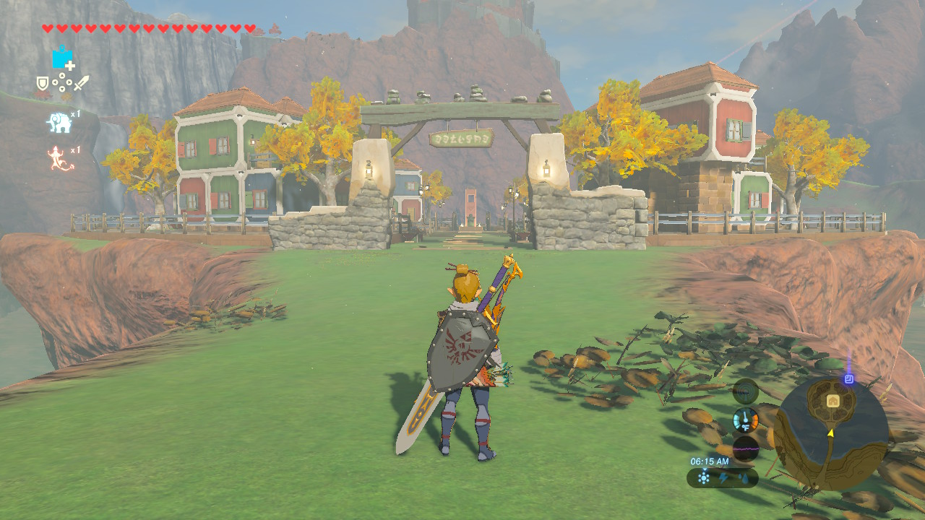
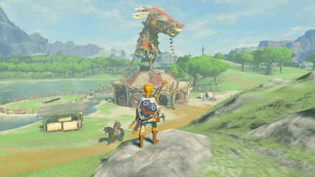
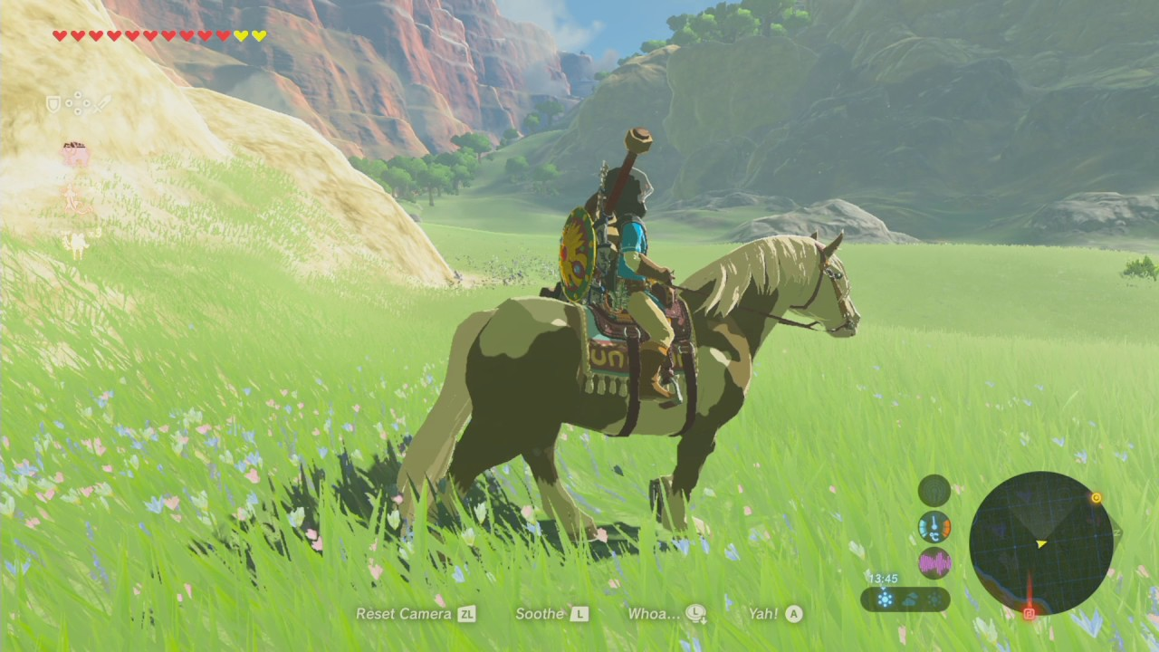
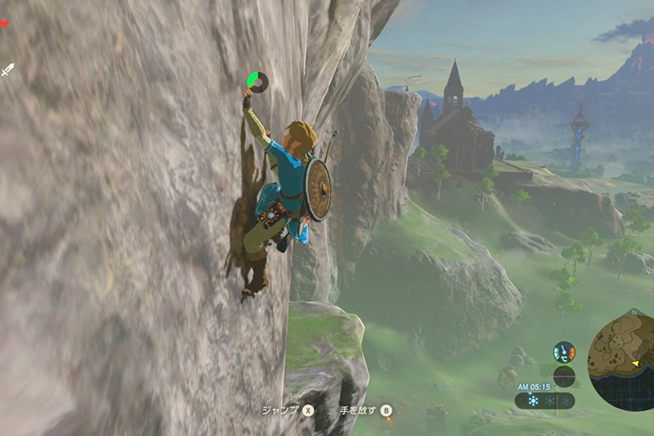
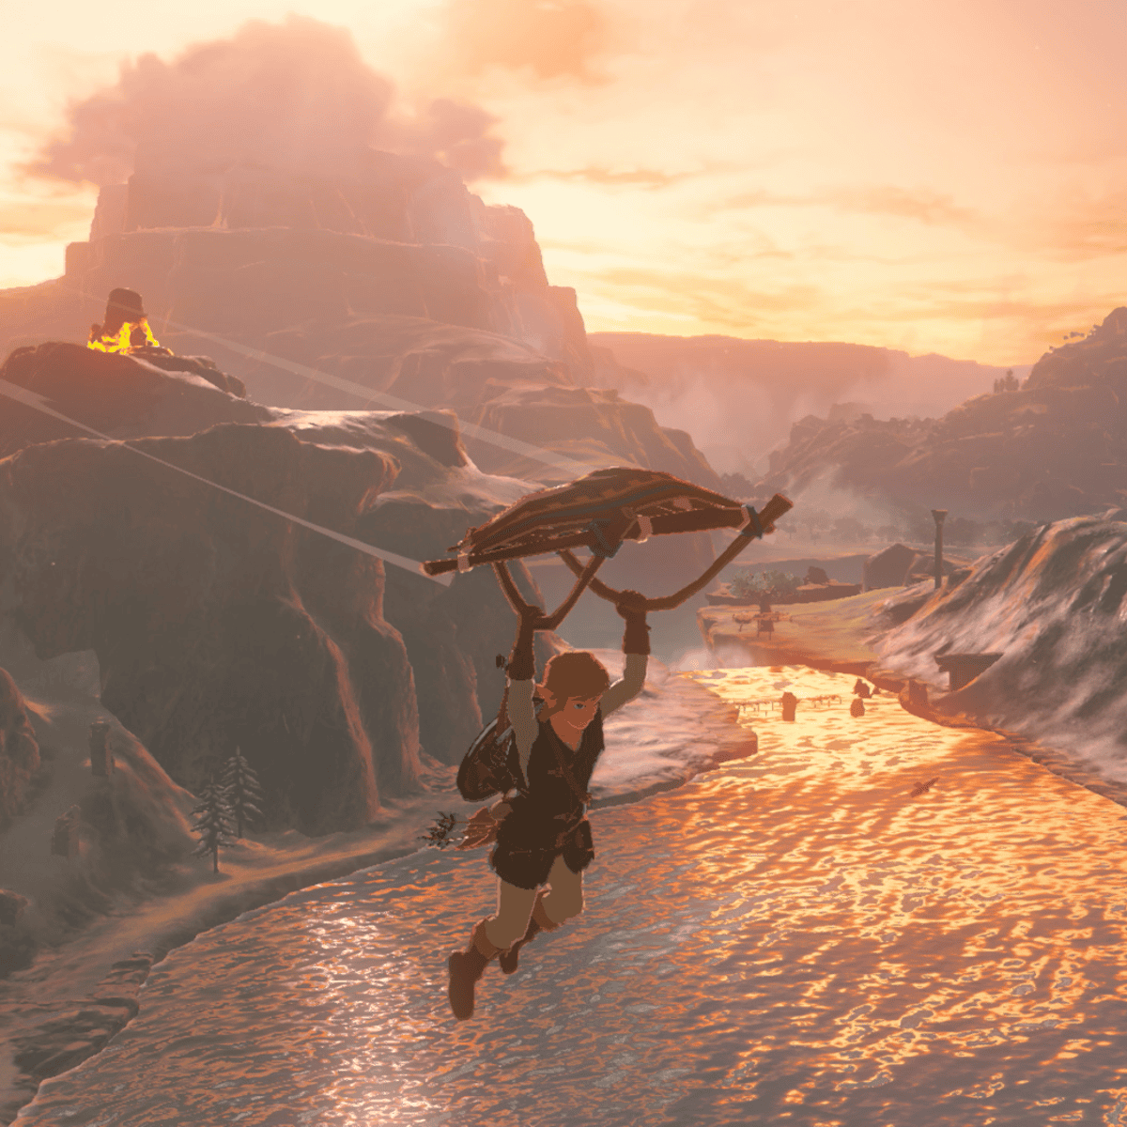
KEY ELEMENTS OF RPG (EXPLORATION & OPEN WORLD)
Points of Interest:
Hyrule is densely populated with points of interest, such as towns, stables, shrines, and unique landmarks. These locations serve as hubs for quests, interactions with NPCs, shops, and opportunities for rest and resupply. Discovering and interacting with these points of interest encourages players to explore the world more extensively, unraveling the game's secrets and unfolding additional storylines.
Environmental Interactions:
BOTW's open world is brimming with interactive elements. Players can climb mountains, glide through the air using a paraglider, swim across rivers and lakes, and even ride horses or tamed wild animals. The game's physics-based interactions also allow for creative problem-solving, such as using the environment to solve puzzles or finding unique ways to defeat enemies.

Slide 11
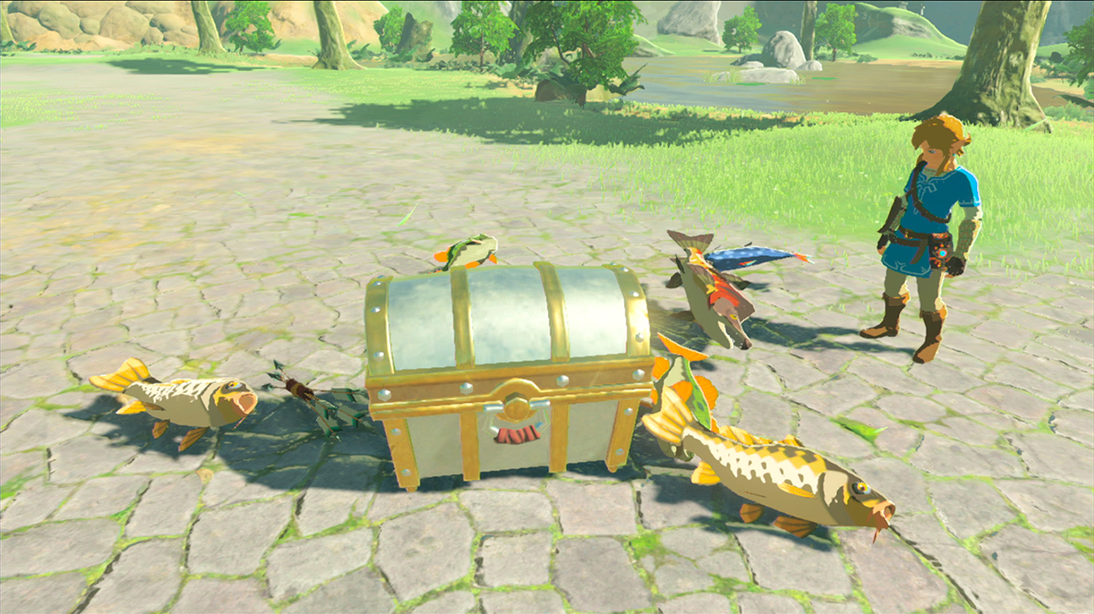
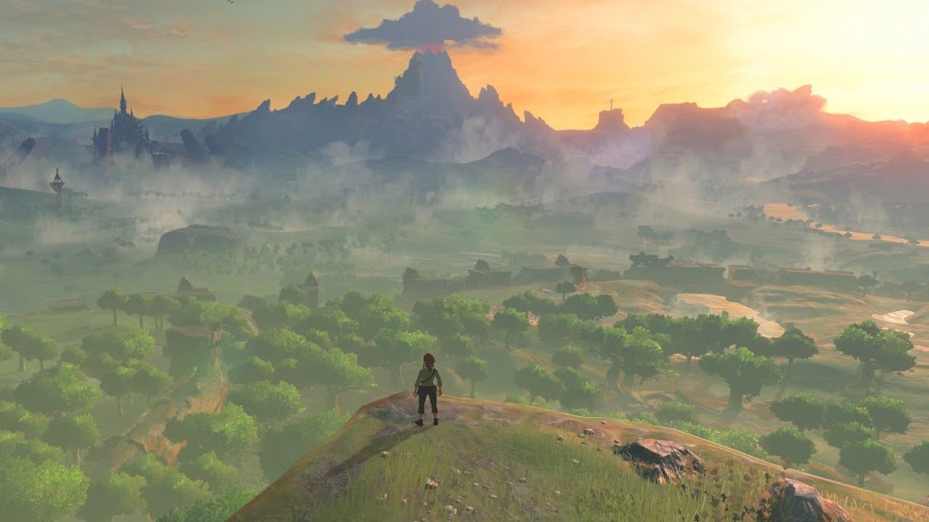
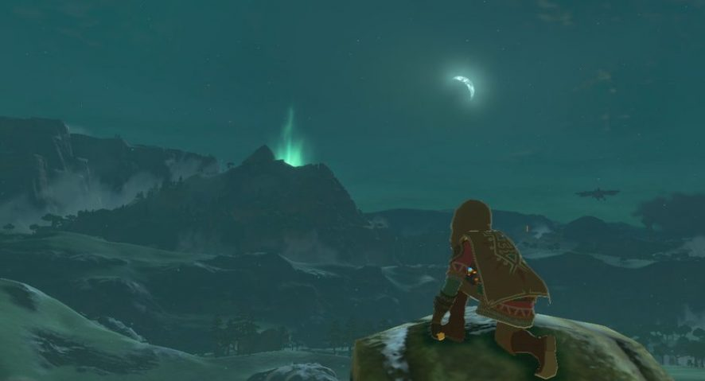
KEY ELEMENTS OF RPG (EXPLORATION & OPEN WORLD)
Discoverable Lore and Secrets:
Exploration in BOTW is rewarded with the discovery of lore-rich locations, hidden treasure chests, and ancient ruins. These findings provide insight into the game's backstory, offer additional context to the world, and often grant valuable items or equipment that aid the player's progression. The sense of wonder and curiosity that comes from exploring and stumbling upon these secrets is a significant part of the game's appeal.
Dynamic Weather and Day/Night Cycle:
BOTW features a dynamic weather system and a day/night cycle. These elements add depth and realism to the world, impacting gameplay and creating dynamic scenarios. Weather conditions, such as rain or thunderstorms, can affect climbing and exploration, while the day/night cycle influences the behavior of creatures and NPCs. The ever-changing environment encourages players to adapt their strategies and explore the world during different times and weather conditions.

Slide 12
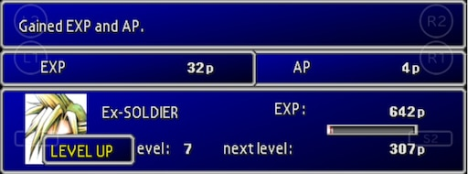
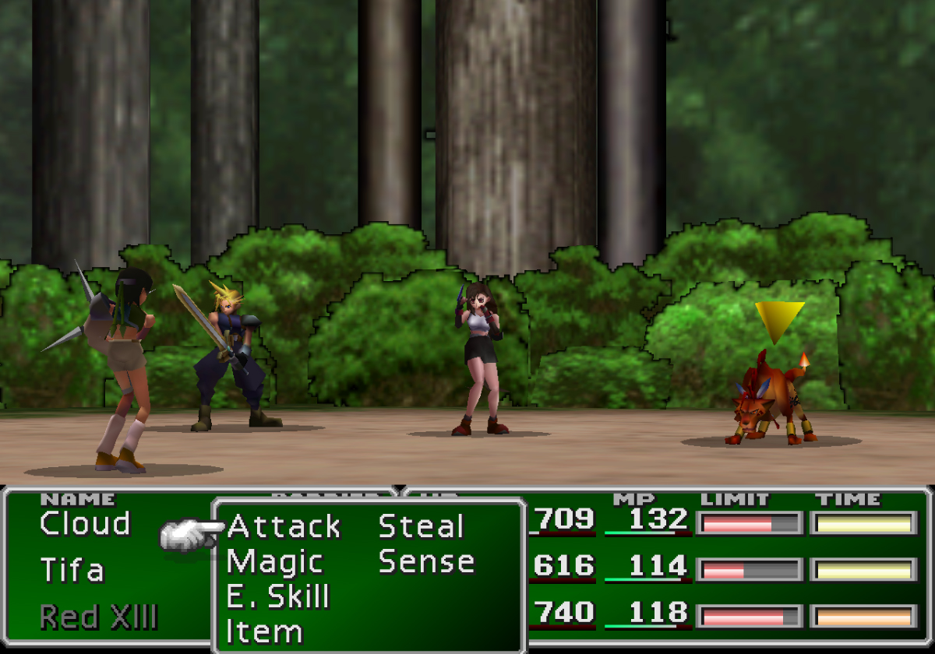
KEY ELEMENTS OF RPG (CHARACTER DEVELOPMENT)
4. CHARACTER DEVELOPMENT AND PROGRESSION
Character development and progression are fundamental aspects of RPG games that allow players to enhance their characters' abilities, skills, and power over time. These mechanics provide a sense of growth and advancement, rewarding players for their efforts and investments. To illustrate these concepts, let’s explore the game example of “Final Fantasy VII”. It is a classic RPG known for its robust character development and progression systems. Here's how the game exemplifies these mechanics:
Leveling up:
In FFVII, characters gain experience points (XP) by defeating enemies in battle. As characters accumulate XP, they level up, increasing their base stats such as strength, magic, HP (health points), and MP (magic points). Higher levels enable characters to face tougher challenges and access more advanced abilities.
Abilities and Skills:
Characters in FFVII possess unique abilities and skills that can be acquired and upgraded throughout the game. These abilities can be combat-oriented, magical, or utility-based. As characters gain levels, they unlock new abilities or improve existing ones, granting them access to a wider range of strategic options in battle.

Slide 13
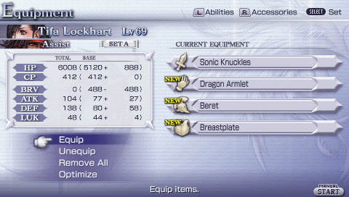
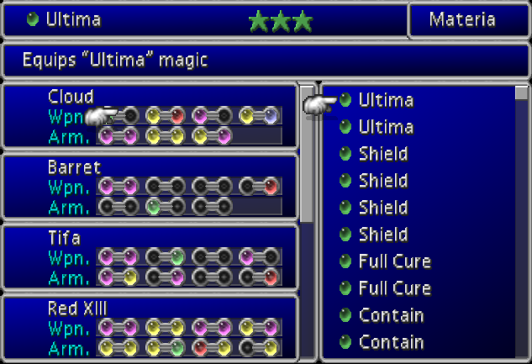
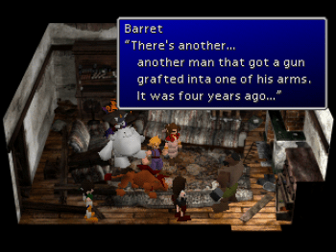
KEY ELEMENTS OF RPG (CHARACTER DEVELOPMENT)
Equipment and Gear:
FFVII features a wide array of equipment, including weapons, armor, accessories, and materia (magical orbs). Equipping characters with better gear enhances their combat effectiveness and provides additional bonuses, such as increased damage, improved defense, or resistance to certain status effects. Characters can acquire new equipment by purchasing or finding them during their journey.
Materia System:
FFVII incorporates a unique materia system, allowing characters to harness magical abilities and spells. Materia orbs can be slotted into weapon or armor slots, granting characters specific magical spells or augmenting their attributes. Materia can level up through usage, becoming more powerful and unlocking additional abilities. This system provides flexibility in customizing characters' abilities and encourages experimentation.
Character Growth and Storytelling:
As characters progress through the narrative of FFVII, their personal stories and relationships develop, leading to emotional growth and character arcs. This character-driven storytelling adds depth and immersion, making the player's investment in their development and progression feel meaningful and rewarding.

Slide 14

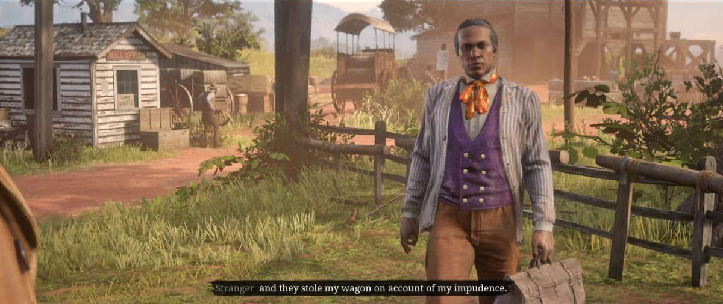
KEY ELEMENTS OF RPG (NPC)
5. NON PLAYER CHARACTERS (NPCs)
Non-player characters (NPCs) are entities in video games that are controlled by the game's artificial intelligence (AI) rather than by the player. NPCs play various roles within the game world, serving as allies, enemies, quest givers, merchants, or simply adding life and atmosphere to the game environment. They are essential for creating immersive and dynamic gameplay experiences. To provide a concrete example, let's examine the game “Red Dead Redemption 2”. RDR2 is an open-world action-adventure game known for its richly detailed world and diverse cast of NPCs. Here's how the game exemplifies the use of NPCs:
Narrative and Storytelling:
NPCs in RDR2 play a crucial role in advancing the game's narrative. They are part of a larger story and often have their own arcs and relationships with other characters. Through interactions with NPCs, players uncover the game's plot, lore, and the personal stories of the characters, creating a deep and immersive narrative experience.
Quests and Missions:
NPCs act as quest givers, providing players with a variety of missions and tasks to undertake. These quests range from main story missions that progress the game's plot to side quests that delve into the lives and struggles of the NPCs. Completing quests for NPCs can unlock new content, rewards, and opportunities for further exploration.

Slide 15
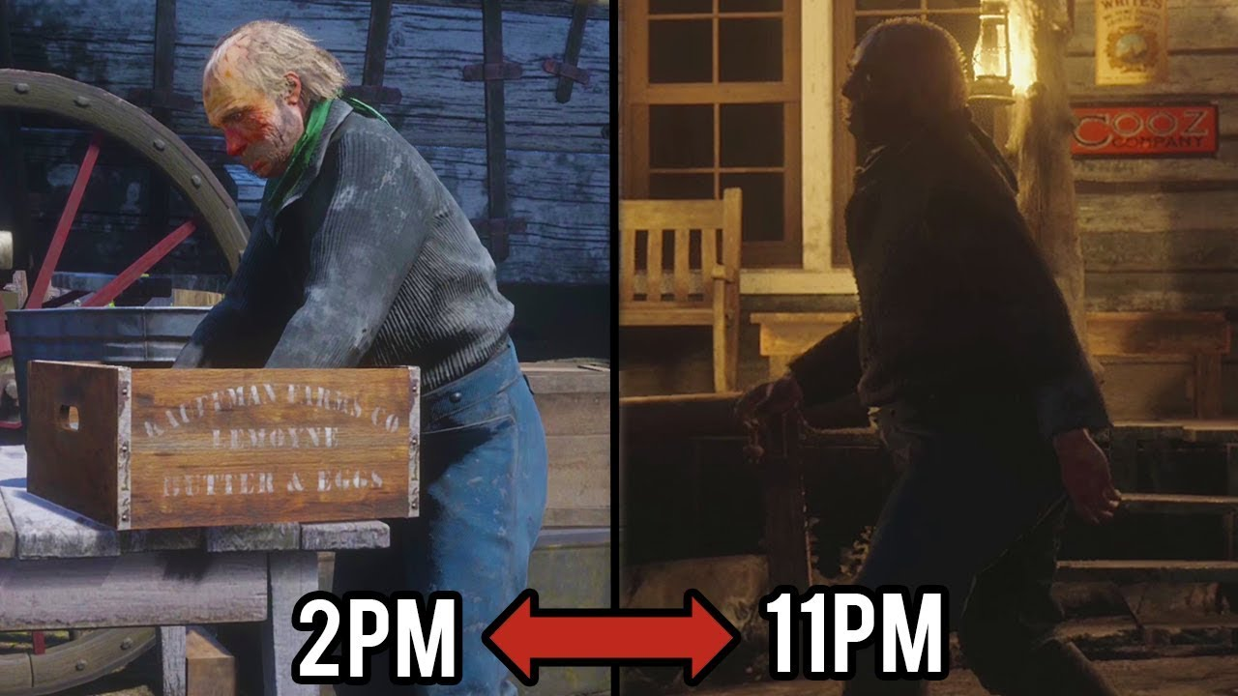
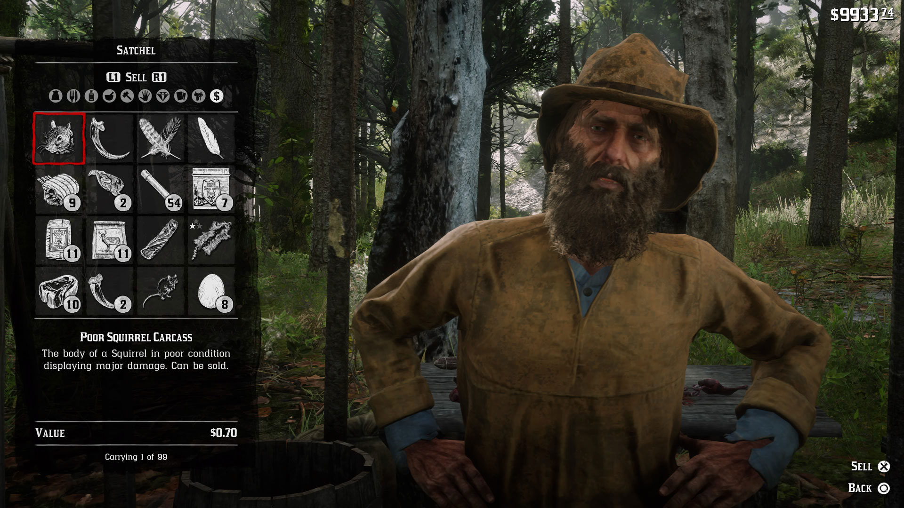
KEY ELEMENTS OF RPG (NPC)
Dynamic Behavior and Routine:
NPCs in RDR2 have their own daily routines and behaviors, which contribute to the game's immersive world. They can be seen going about their lives, engaging in activities like farming, hunting, or socializing. NPCs react to the player's actions, weather conditions, and time of day, creating a living and reactive game environment.
Commerce and Services:
NPCs in RDR2 function as merchants, offering a range of goods and services. Players can buy supplies, weapons, clothing, or even sell items to these NPCs. Additionally, NPCs may provide essential services like blacksmithing, horse grooming, or medical assistance. These interactions contribute to the game's economy, resource management, and player progression.

Slide 16
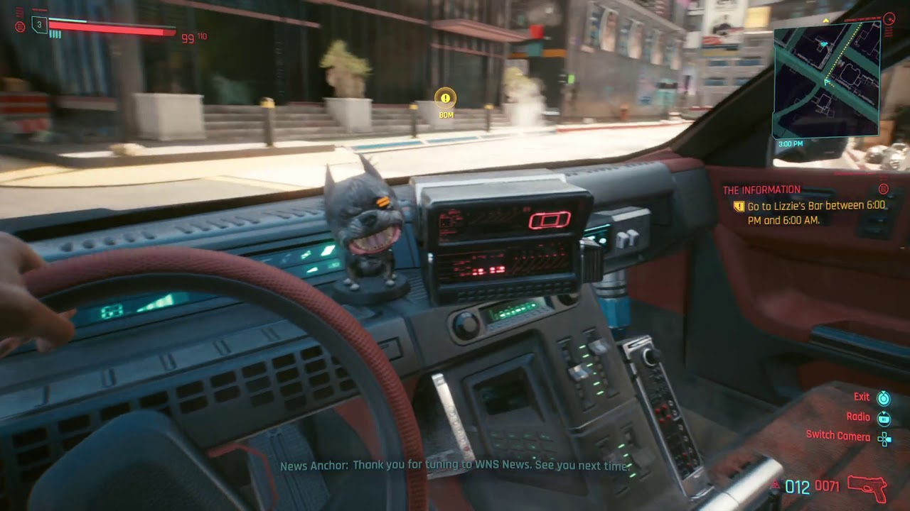
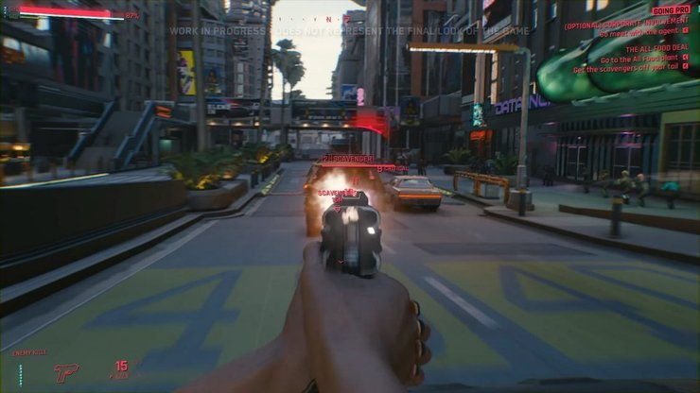
KEY ELEMENTS OF RPG (COMBAT & MECHANICS)
5. COMBAT & GAMEPLAY MECHANICS
Combat and gameplay mechanics play a crucial role in shaping the experience of a game like "Cyberpunk 2077." Developed by CD Projekt Red, "Cyberpunk 2077" is an open-world action RPG set in a futuristic, dystopian city. Let's delve into the combat and gameplay mechanics of the game:
First Person Perspective:
"Cyberpunk 2077" utilizes a first-person perspective, immersing players in the futuristic world of Night City. This perspective enhances the sense of immersion and allows players to engage more directly with the game world.
Gunplay and Weapons:
The game offers a wide variety of firearms, melee weapons, and cybernetic enhancements. Players can engage in intense gunfights and customize their loadout with different weapon types, such as pistols, shotguns, rifles, and futuristic tech weapons. Each weapon has unique characteristics, including damage, accuracy, and rate of fire, which allows players to approach combat encounters with diverse strategies.

Slide 17
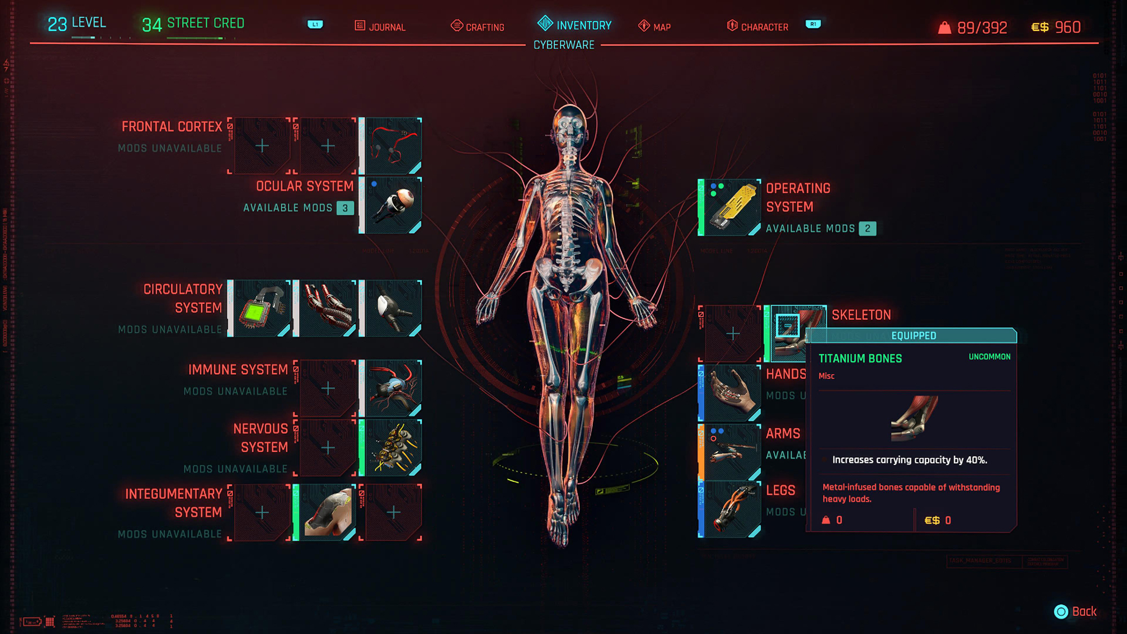
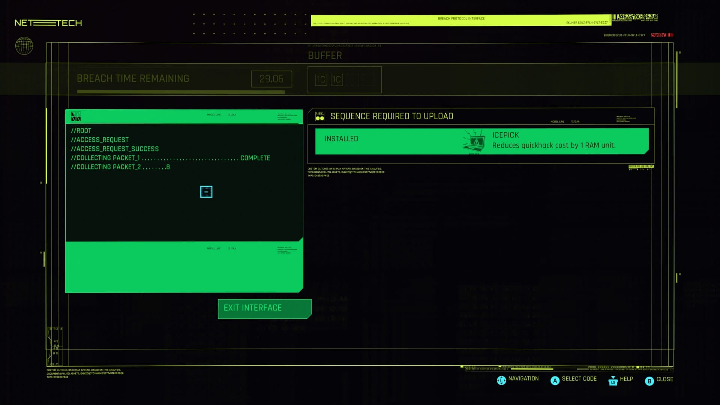
KEY ELEMENTS OF RPG (COMBAT & MECHANICS)
Cyberware and Augmentations:
Players can enhance their character with cybernetic implants and augmentations that grant unique abilities and combat advantages. These cyberware enhancements range from cybernetic limbs that enhance strength and agility to ocular implants that offer enhanced vision modes. Players can choose from a wide range of cyberware options to suit their playstyle and enhance their combat effectiveness.
Hacking and Netrunning:
Players can enhance their character with cybernetic implants and augmentations that grant unique abilities and combat advantages. These cyberware enhancements range from cybernetic limbs that enhance strength and agility to ocular implants that offer enhanced vision modes. Players can choose from a wide range of cyberware options to suit their playstyle and enhance their combat effectiveness.

Slide 18
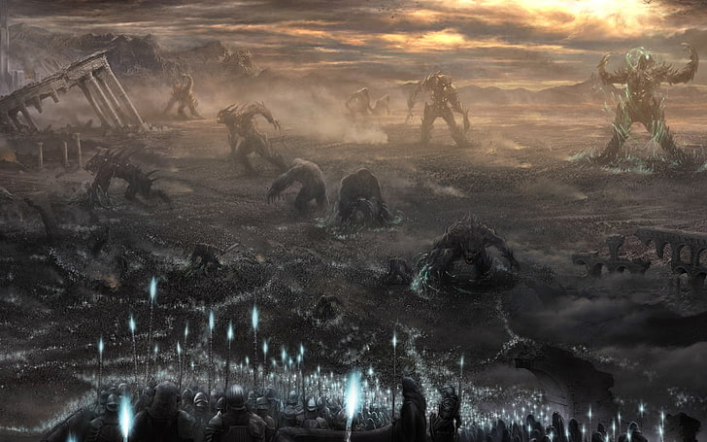
MY GAME PROPOSAL (PROLOGUE)
Prologue:
Once upon a time Demon King lucifer escapes from the hell and take shelter in a World called Tellus. The world was filled with rich green gardens, dark forests, blue lakes and large mountain peeks. There were different kingdoms with just rulers from the noble families. Lucifer saw an opportunity and unleashed his army of demons into Tellus. All kings allied their strengths to fight Lucifer’s army with their elite warriors.

Slide 19
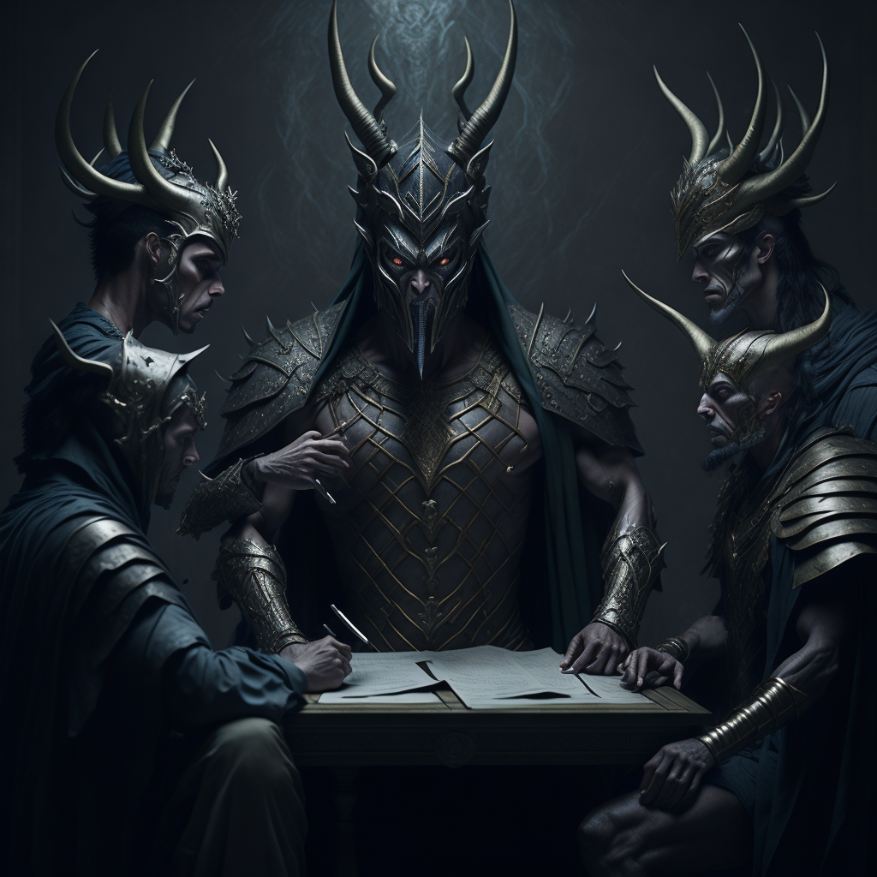
MY GAME PROPOSAL (PROLOGUE)
There were a lot of causalities on both sides. Kings wanted to finish this war of bloodshed and raise their hands towards demon king for an agreement. Lucifer being cunning and mischievous made an offer that kings couldn’t refuse. He said he will send most of his demons back to hell but every Kingdom needs to send him certain human sacrifices every year in return, he’ll even provide them protection from otherworldly and human evils.

Slide 20


MY GAME PROPOSAL (PROLOGUE)
Lucifer spread some of his minions throughout the Tellus and Gave Kingdoms huge walls to stay away from any threats. For hundreds of years trades of human sacrifices remain happening between lucifer and great Kingdoms. At first criminals were sent to him but later people stopped doing crimes and anyone with low authority or low poverty level were sent to lucifer. Later kings became tyrants to save their own families and created slums for farming week humans that were supposed to be used as sacrifice.

Slide 21

MY GAME PROPOSAL (MAIN GAME THEME)
Son of king was bullying someone and son of one of Elite warriors tries to stop son of king and he starts fighting with chief warrior’s son. Chief warrior’s son breaks prince’s arm during the fight. Later on Tyrant king punishes warrior’s son to be sent as sacrifice. His father couldn’t do nothing but he asked King to allow him to drop his son till the kingdom gate before handing over to the demons. While saying last good bye chief warrior unlocks the lock and advises his son to run away while in the dark and take shelter.

Slide 22

MY GAME PROPOSAL (MAIN GAME THEME)
He gives his son a pendant that has the power to guide him to achieve his destiny. Now this son is our protagonist and follow his father’s advice. Run from the sacrificial cart and fall into a crypt in the darkness. In the crypt he finds treasure of Elite warriors of the past and Ghost that will train him to live his life outside the wall. Now protagonist is said to explore the world, kill demons of different levels and gain experience. He visits different Kingdoms and make friends with democrats. In the end he is to overthrow all the tyrants and be enough powerful launch a full scale war against lucifer, Lucifer being the final boss who he is supposed to battle in the end.

